Slide 1

Advancing the African Regional Framework for Cervical Cancer Elimination in Nigeria:
Enhancing Routine HPV Immunization &
Defining the Next Steps
Prof. O. K. Ogan Memorial Lecture
SOGON
Cyril Chukwudi DIM
[MB.BS, Euro. MSc (Int'l Hlth), MSc (Physiol), MD, FWACS, FMCOG]
Professor / Consultant Obstetrician & Gynaecologist
College of Medicine, University of Nigeria, Ituku-Ozalla
29th Nov. 2024

Slide 2
Any conflict?
None
Slides – mine

Slide 3

SOGON President & Council

Slide 4
Past Prof O. K. Ogan Memorial Lectures
Year | Conference | Lecturer
2020 | 54th AGM / Scientific Conference (Lagos) | Prof. Oladapo Shittu
2015 | 49th AGM / 9th International Conference (Abuja) | Prof. Osato Giwa-Osagie
2013 | 47th AGM / Scientific Conference (Lagos) | Prof. O.B. Osinusi
2006 | 40th AGM/ 7th International Conference (Abuja) | Prof. B.C. Ozumba
2002 | 36th AGM / 6th International Conference (Abuja) | Prof. V. C. Egwuatu
1998 | 5th International Conference (Benin) | Prof. W.O Chukudebelu

Slide 5
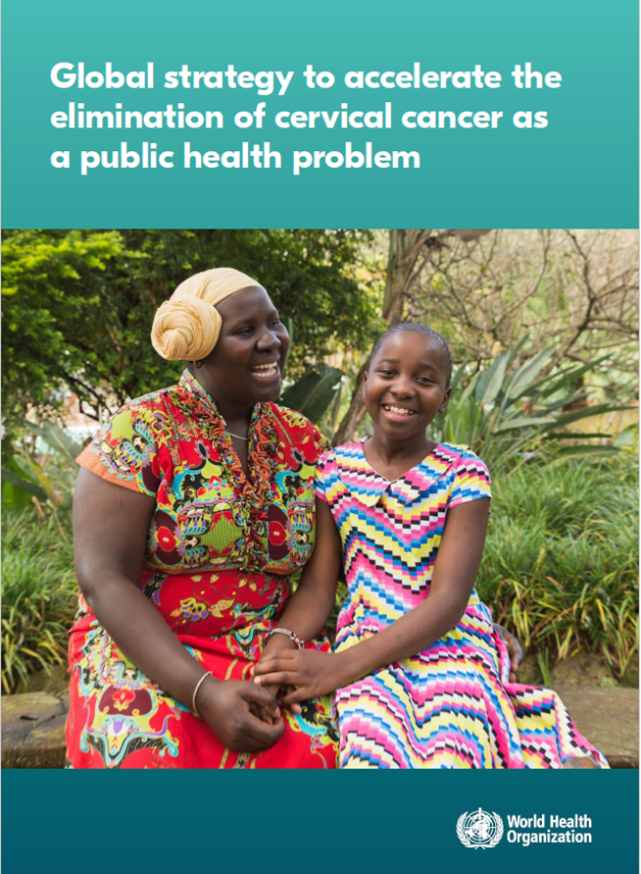
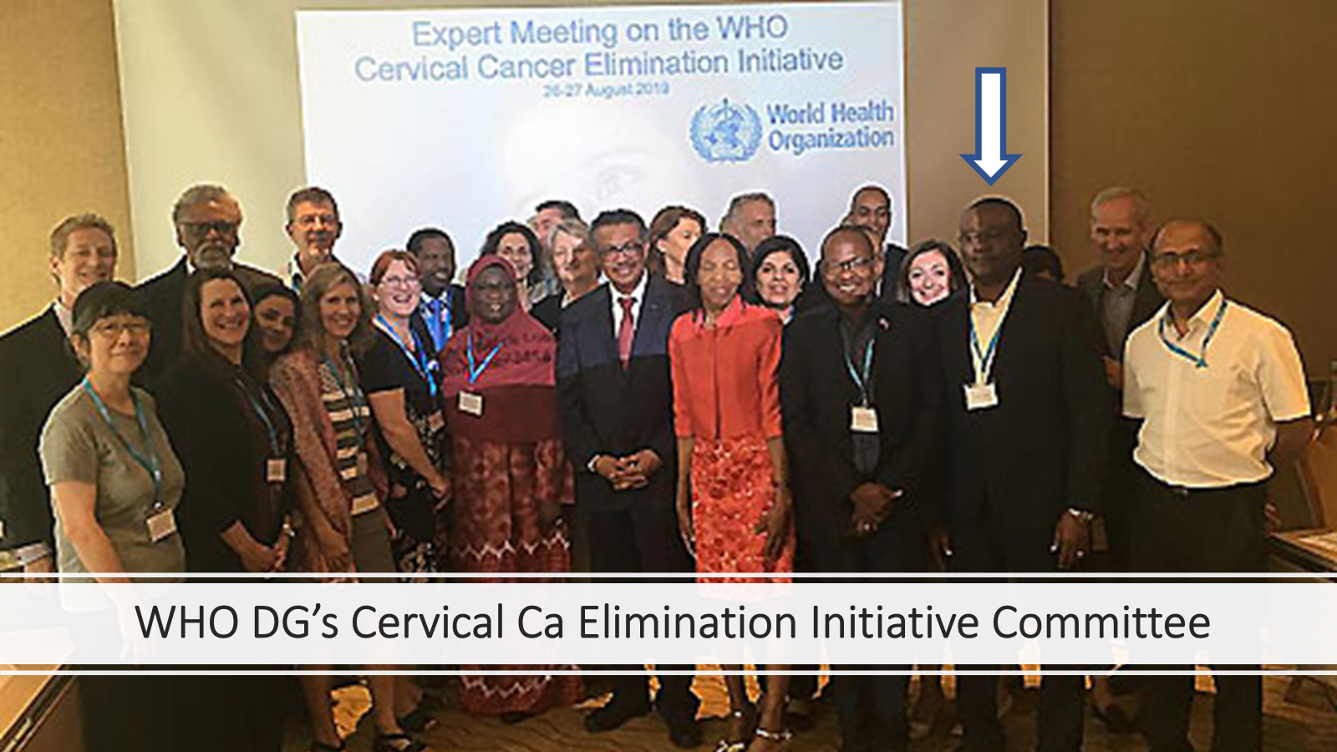
https://www.who.int/initiatives/cervical-cancer-elimination-initiative

Slide 6
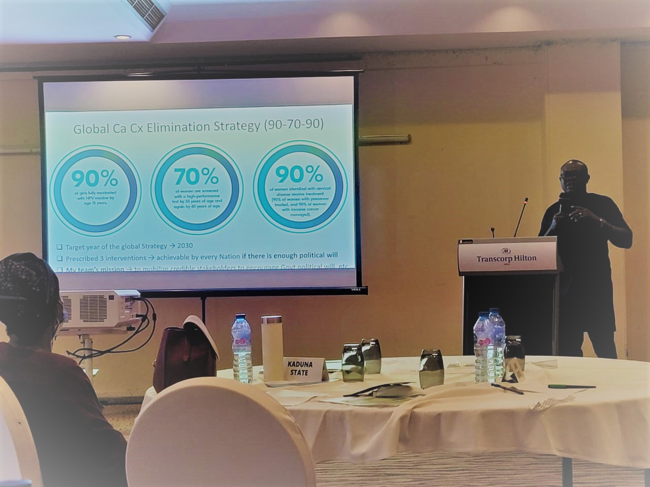
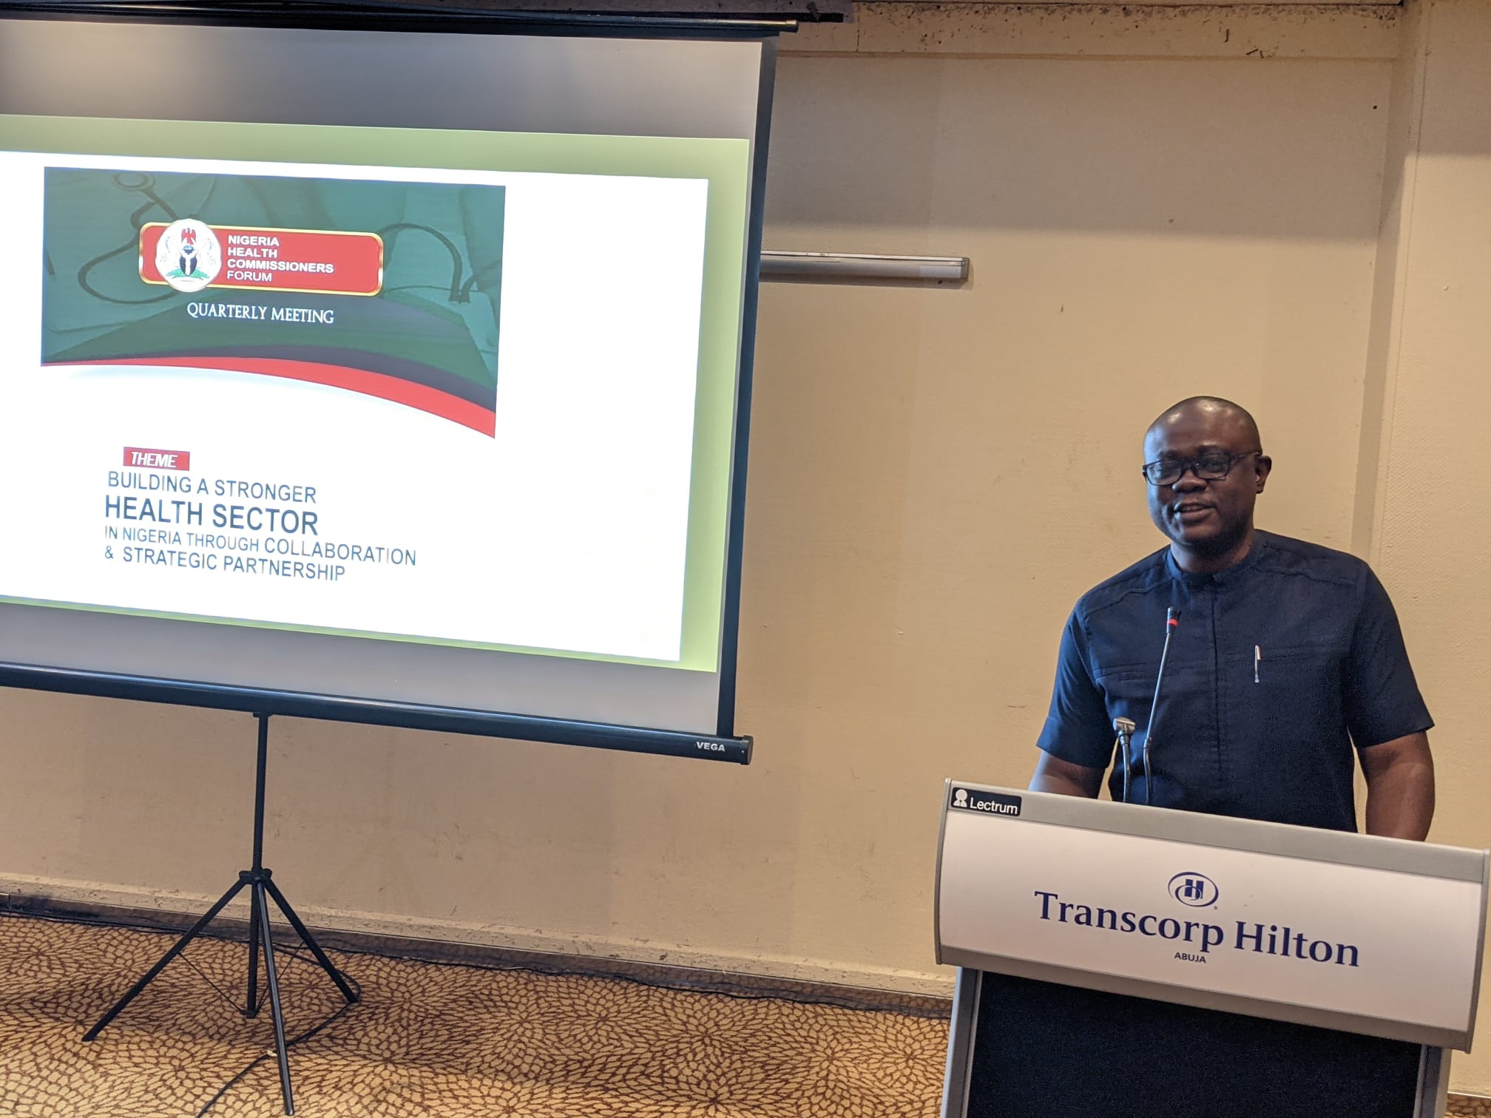
Addressing the Nigeria Health Commissioner Forum

Slide 7
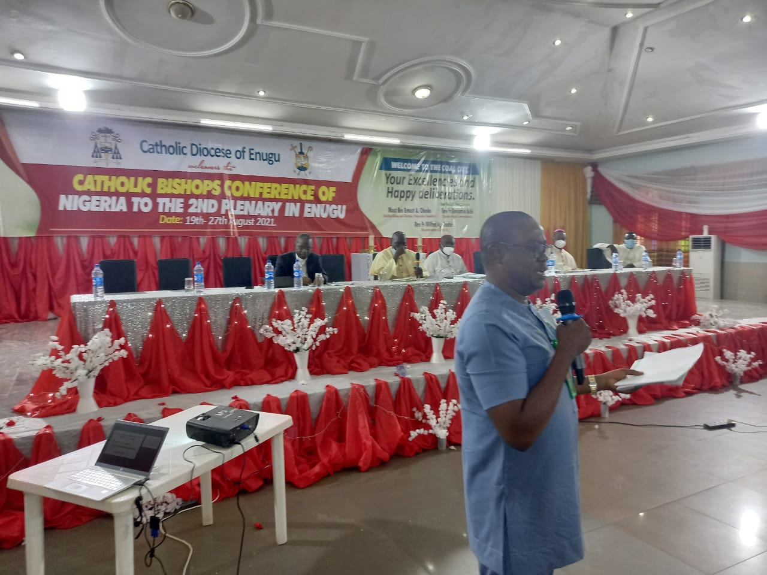
Addressing Catholic Bishops Conference of Nigeria
https://www.who.int/news/item/23-08-2021-calling-catholic-bishops-to-join-the-movement-for-cervical-cancer-elimination-in-nigeria

Slide 8
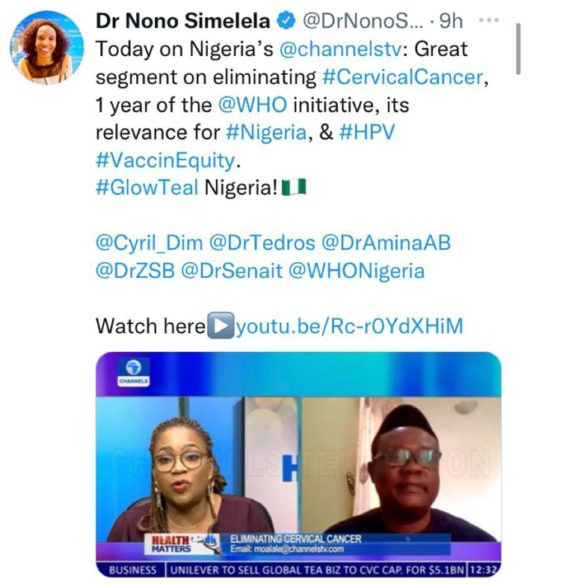
Advocacy through Media - Channels TV
With Dr Philip EKPE
Consultant OB-GYN FCT Abuja & Former Secretary General, Nigerian Medical Association
Health Matters, Saturday 20th Nov. 2021
- Video is available @ https://www.youtube.com/watch?v=Rc-r0YdXHiM&t=494s

Slide 9
Outline
Preamble / Introduction
About Prof Okoronkwo Kesandu OGAN
Burden & Disease Course of Cervical Cancer
World Health Organization Cervical Cancer Global Elimination Strategy
The African Region Framework for Implementing the WHO-90-70-90 Strategy
Objectives & milestones of the Framework
Initiation of Routine HPV Immunization in Nigeria – a good first step
Defining the Next Steps for CC elimination in Nigeria
Enhancing Routine HPV Immunization
Conclusion
Developing Routine CC Screening and pre-cancer treatment
Scaling up of CC treatment

Slide 10

About Prof Okoronkwo Kesandu OGAN
(6th Jan, 1919 – 24th Aug. 1980)
1st OB-GYN from Nigeria
1st Lecturer/Consultant OB-GYN UCH, Ibadan
1st Professor & Chair, Dept. of O & G UNN
1st President of SOGON
Etc

Slide 11
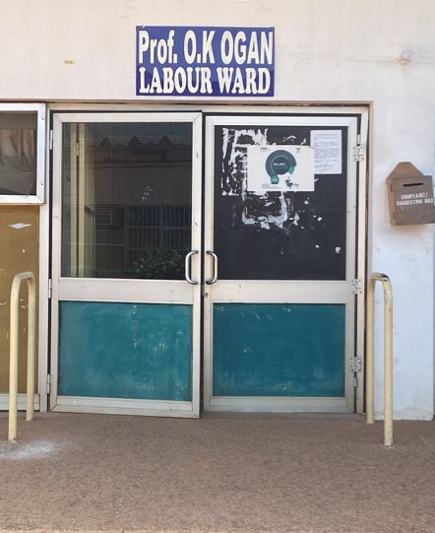
UNTH Labour Ward Named after Prof OK OGAN

Slide 12
“….a gentleman of impeccable manners and amiable disposition, …. he recognized and appreciated quality and excellence……, (he) always expressed his thoughts, views, and feelings unapologetically,
…. He would always truly and patiently listen to others. He abhors bribery and corruption, duplicity and ostentation.”
(Prof VC Egwuatu, 2016)
Prof. O.K Ogan was:

Slide 13
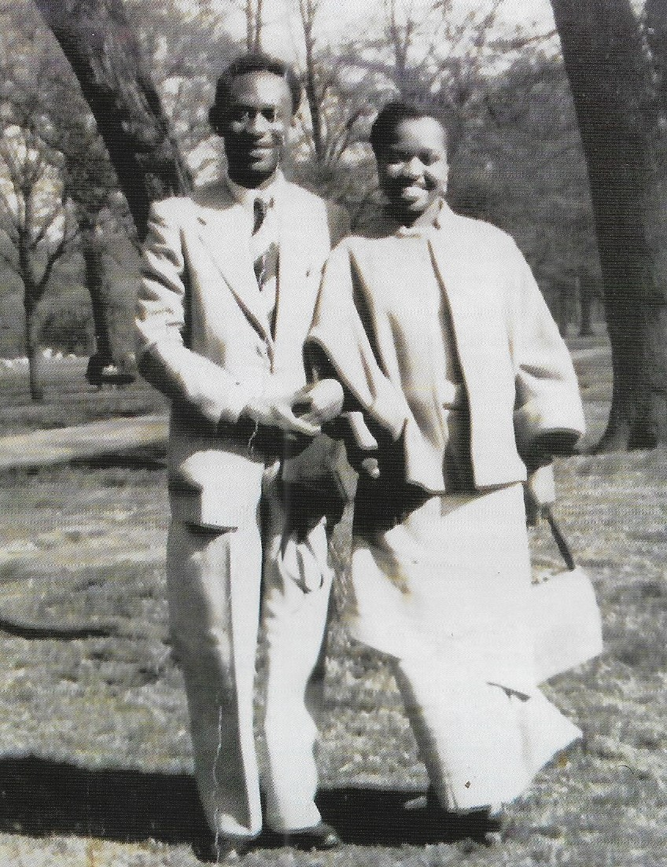
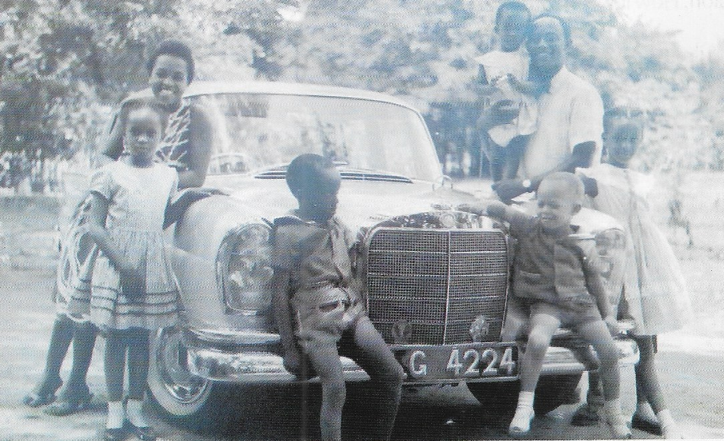
…. an affectionate husband and father….

Slide 14
Introduction

Slide 15
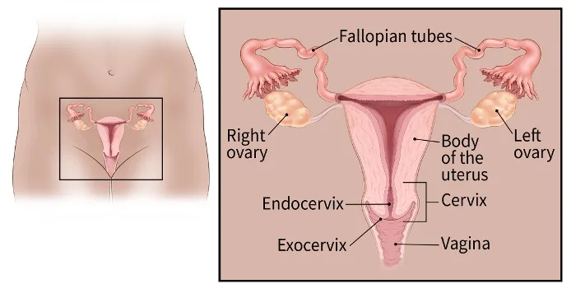
The Cervix Uteri
(https://www.cancer.org/cancer/types/cervical-cancer)

Slide 16
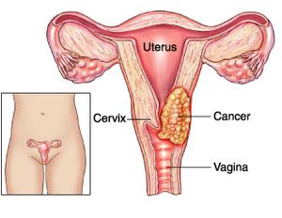
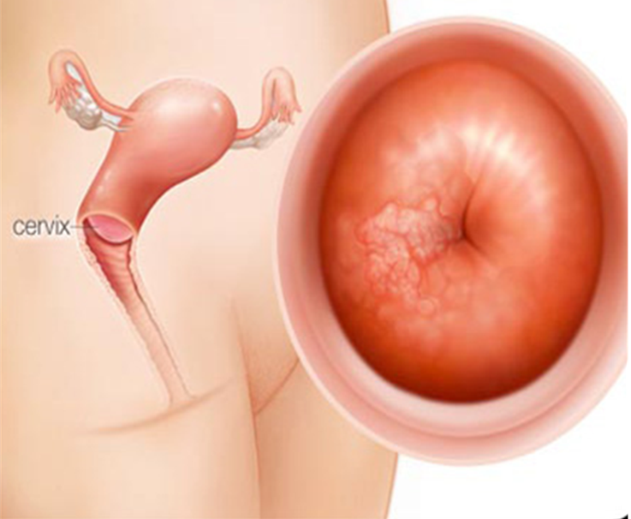
Burden & Disease Course of Cervical Cancer
https://www.physio-pedia.com/Cervical_Cancer
https://www.medicinenet.com

Slide 17
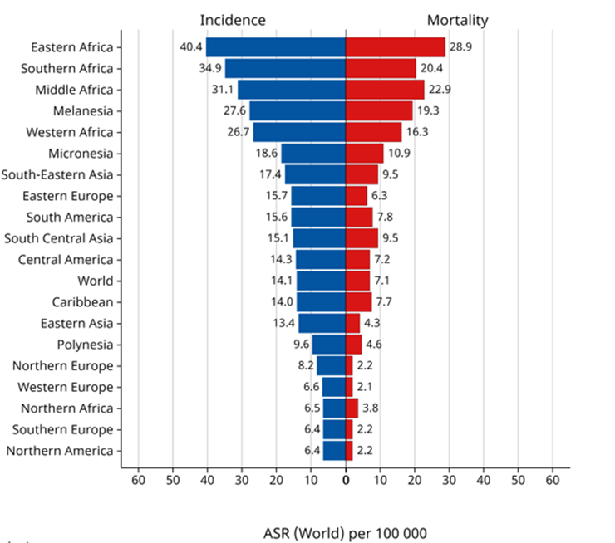
Burden of Cervical Cancer
New cases/yr globally about 660,000
Globally → 4th commonest ca in women
Africa → 4th
sub-Saharan Africa → 2nd
Nigeria → 2nd
Deaths/yr globally about 350,000
Globally → 3rd commonest Ca deaths in women
About 94% → LMICs
sub-Saharan Africa → 1st
Nigeria → 2nd
Africa → 4th
Global incidence & mortality rates of CC (Globocan 2024)

Slide 18
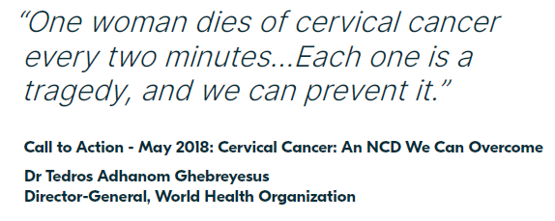
i.e., about 10 women die of Ca Cx in 20 minutes →
about 3 (21%) of them are in Africa – this should worry us

Slide 19
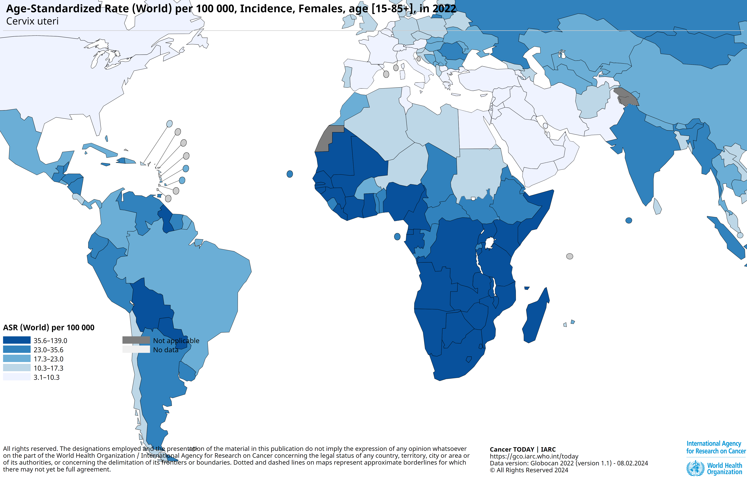
Nigeria
CC Incidence – World

Slide 20
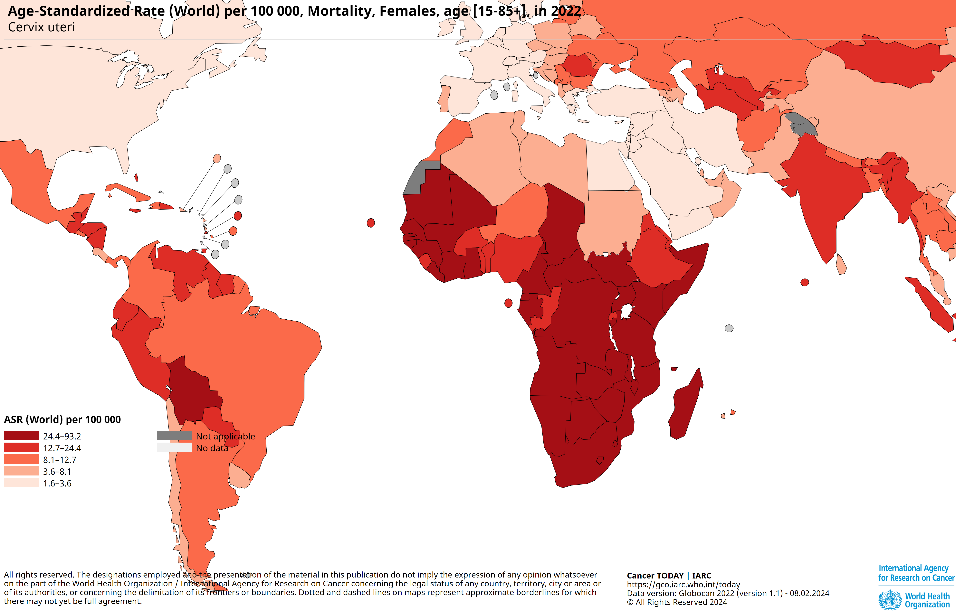
CC Mortality – World

Slide 21
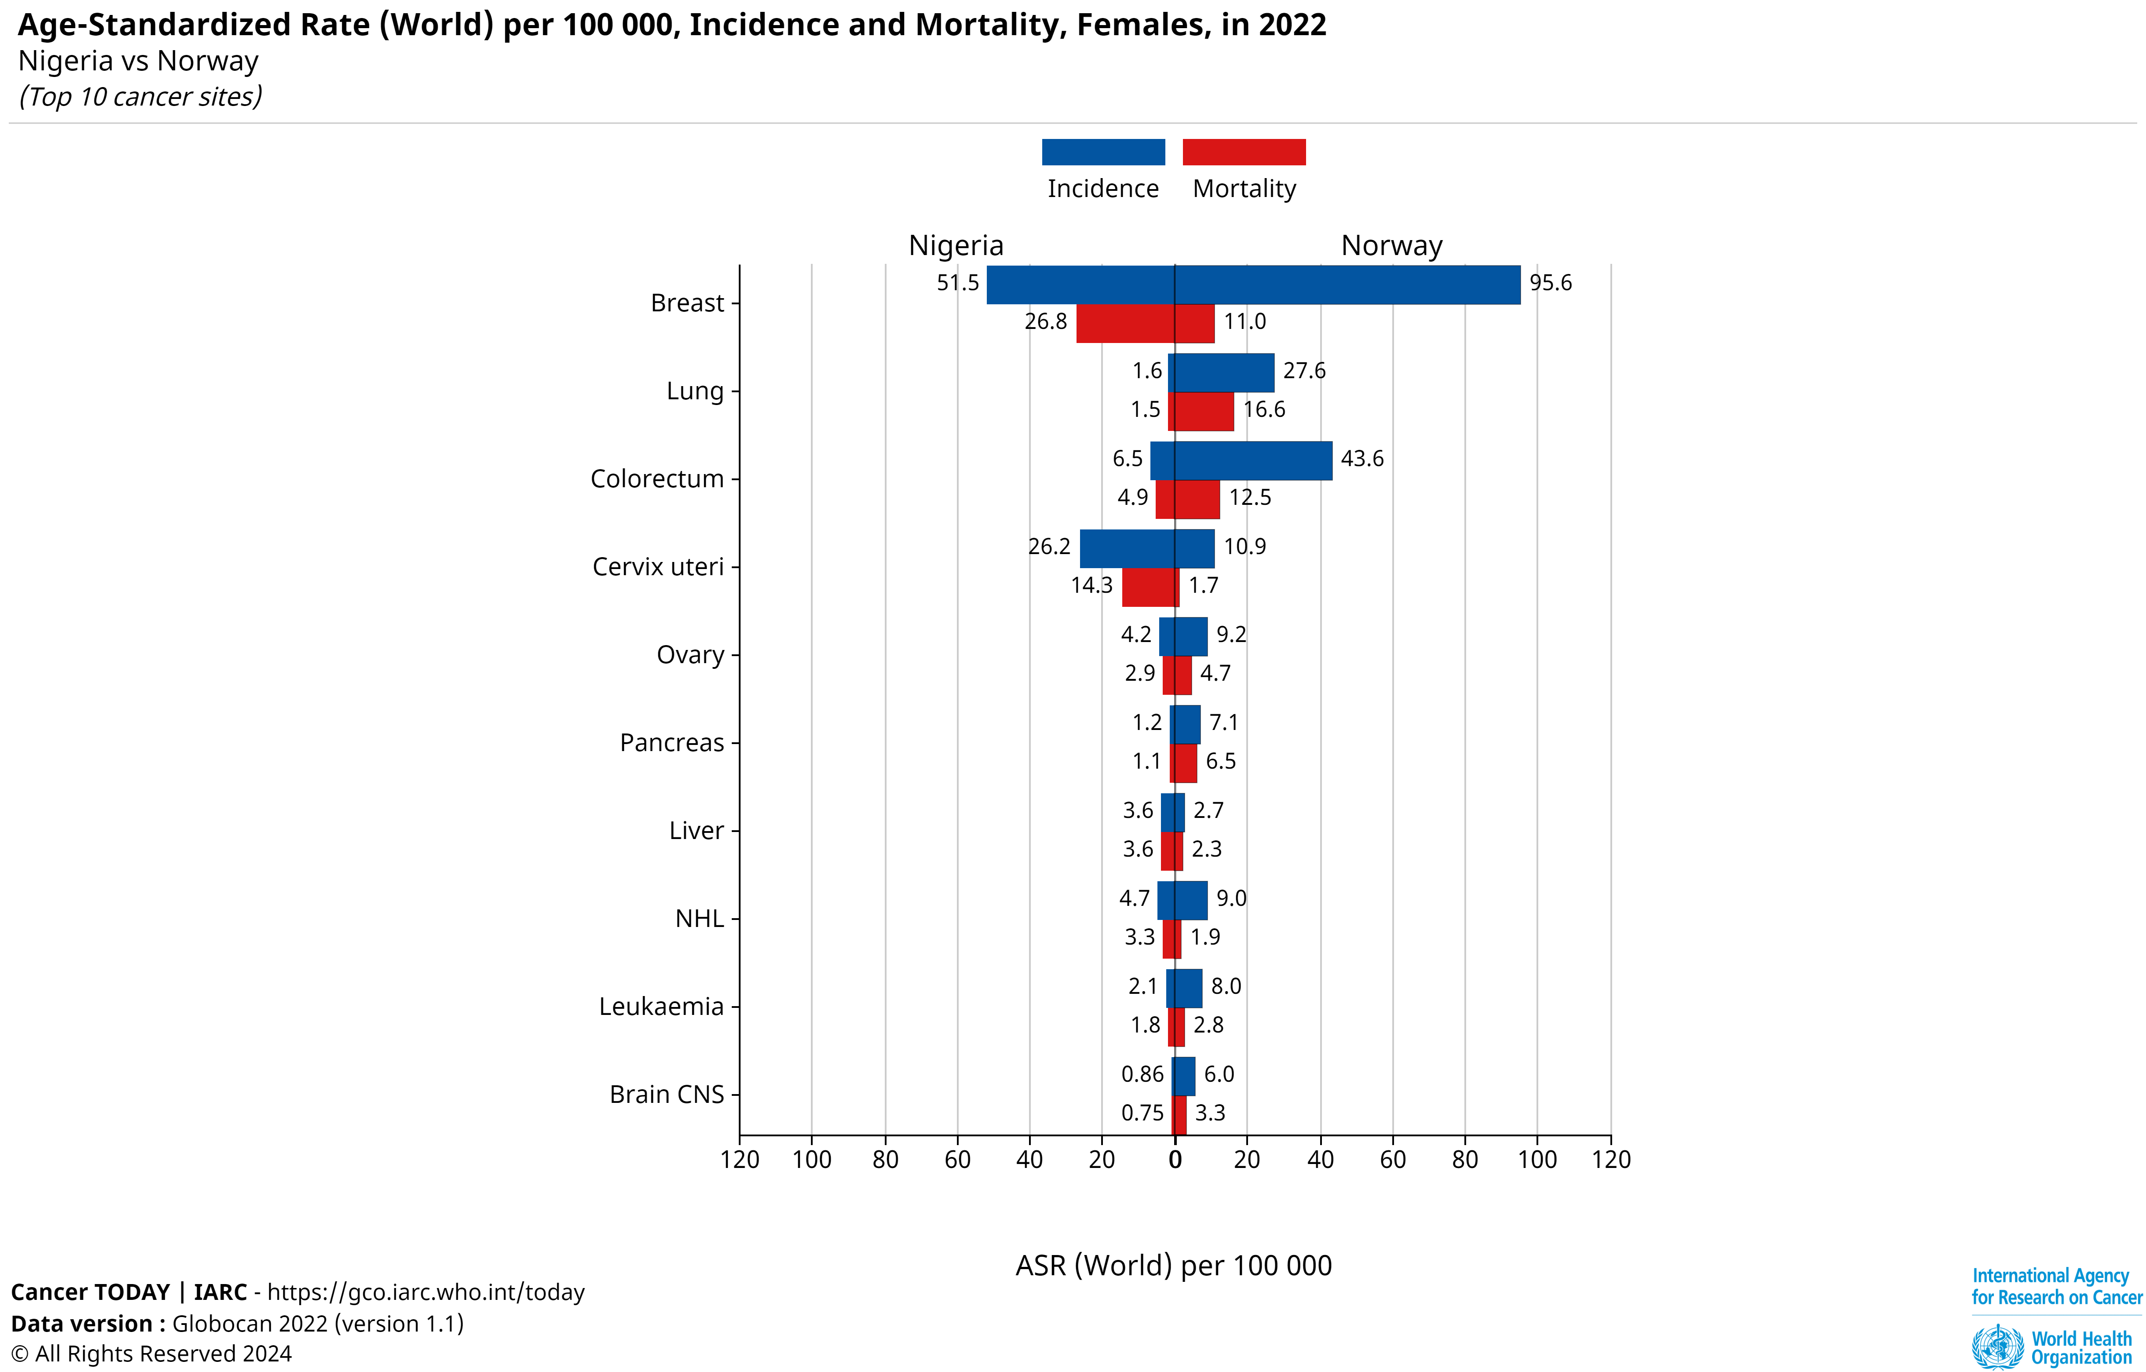
CC Incidence & Mortality
Nigeria Vs Norway

Slide 22
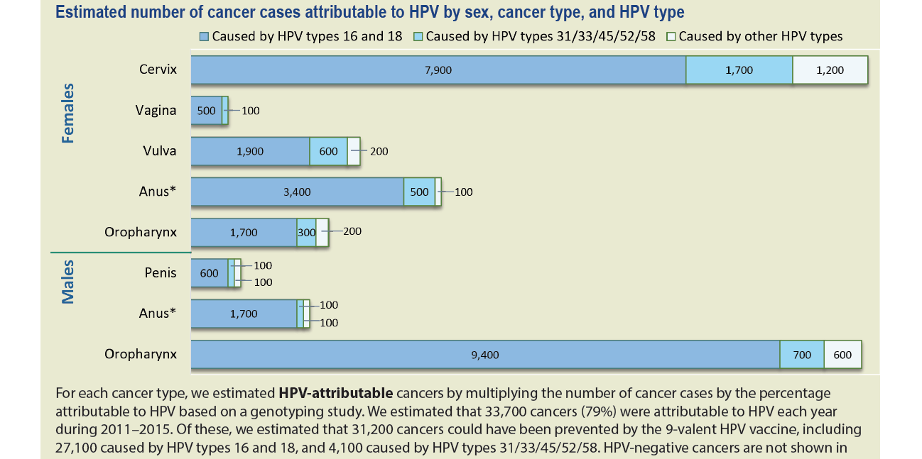
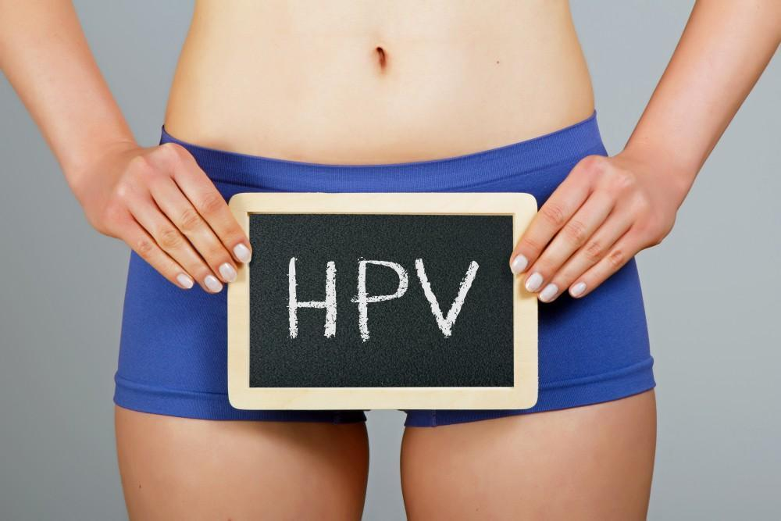
CC = HPV-attributable → hrHPV
hrHPV = Sexually transmitted

Slide 23
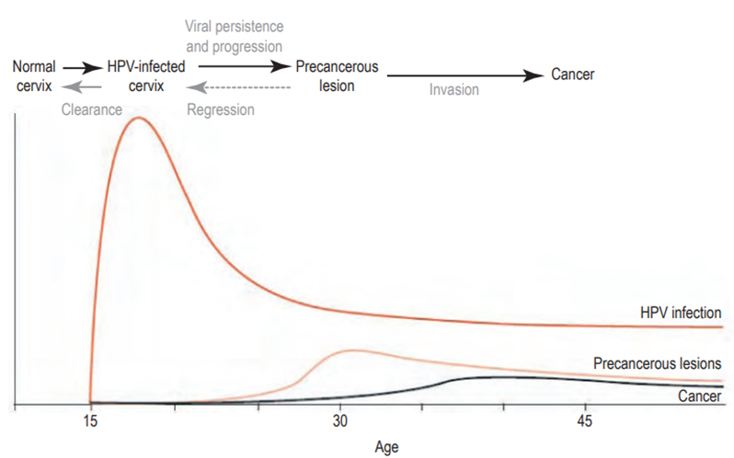
Natural History of HPV & Cervical Pre-cancer & Cancer
(Schiffman & Castle, 2005)
Cervical cancer → A rare complication of persistent infection with hrHPV

Slide 24
Cervical Cancer – Peculiar Xtics
Viral in origin → HPV-attributable
Persistent infx by high-risk HPV types
About 14 HPV types: types 16 & 18 → over 70% of the disease
  Opportunity for primary prevention of CC – HPV vaccines
Prolonged precursor (precancer) stage = cervical intraepithelial lesion
  Detectable by routine screening & treatable (Secondary prevention)
Ca cx → Early & Late stages
Early-stage → curable
Late-stage → No cure (palliative treatment only!)

Slide 25

WHO Global cervical cancer elimination Strategy

Slide 26
Historic – why?
1st time the world is committing to eliminating a cancer
  That cancer = Cervical cancer
194 WHO member countries collectively resolved to eliminate cervical cancer
  Adopted a strategy developed for that purpose
  “Global strategy to accelerate the elimination of cervical cancer as a public health problem”
  Global strategy launched 17th November 2020 (despite COVID-19 pandemic)
  4th anniversary - 17th November 2024

Slide 27
Goal →To eliminate cervical cancer as a Public health problem globally
To Achieve this goal
All countries → reach & maintain an incidence rate < 4 per 100,000 women

Slide 28
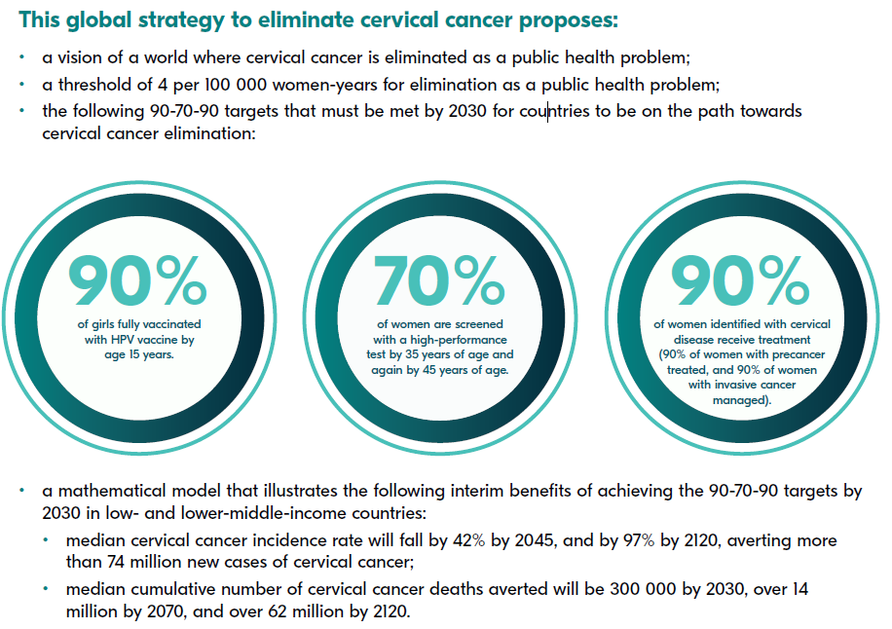
Summary

Slide 29
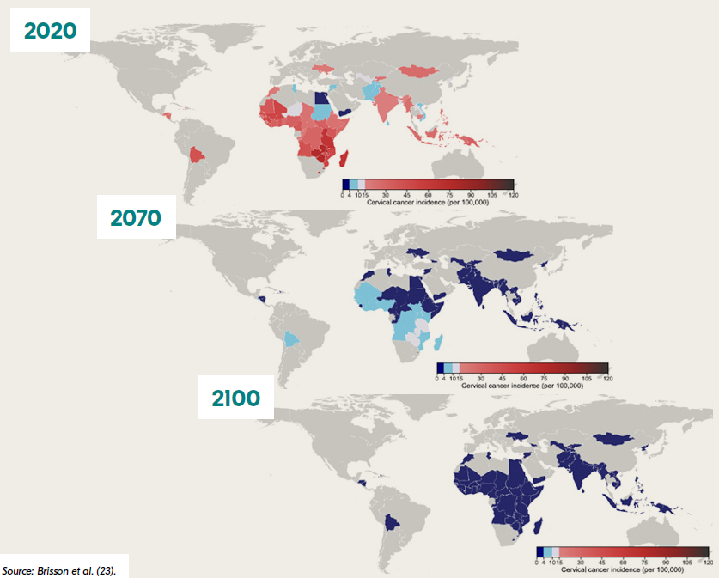
Projected Ca Cx Incidence if Developing Nations achieve the 2030 target & sustain it?

Slide 30
So, what is Africa Doing?

Slide 31
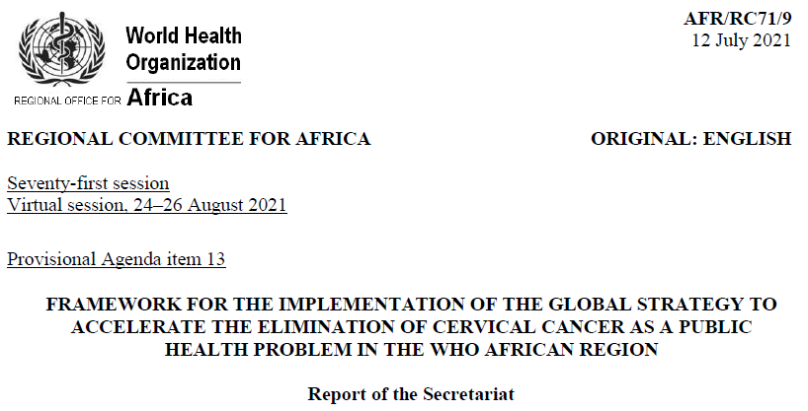
Vision: An African Region free of Ca Cx a public health problem
Goal: To ultimately eliminate Ca Cx as a public health problem in the African Region

Slide 32
Africa Situation
Highest burden of CC globally
21% of global Ca Cx mortality in 2020, 23% in 2022
  Propagated by high HIV prevalence (Ca CX = 6X more likely in HIV women)
Only 16 (33%) Nations have existing HPV vaccination programmes
  Hindered by HPV vaccine distribution inequity
    Between developed Vs developing countries
National screening & treatment programmes for general population are limited & characterized by:
  low-performance screening tests – VIA, Pap test
  Poor participation rate (< 10%) due to many barriers
    e.g., lack of organized programmes, ineffective population outreaches, unavailable infrastructure & limited financial resources

Slide 33
Africa Situation -2
Low or no budgetary allocation specifically for cervical cancer prevention & control
Ca Cx diagnoses → usually at late stage
  When access to treatment (cancer surgery, radiotherapy, & chemotherapy) are limited
  Including limited quality pathology service & palliative care
  Up to 77% of Ca Cx die within 5 years
Inadequate skilled human resources for cancer prevention & control
  Including pathologist & oncologist
    Uneven geographical distribution of existing ones
Inadequate infrastructure for tertiary management
  Inaccessible quality pathology infrastructure & treatment options.
  Radiation therapy is only available in a few Nations
  Poor health insurance: Cancer treatment →associated with catastrophic health expenditure
Weak monitoring and evaluation system – only 6 nations have quality Ca Registries

Slide 34
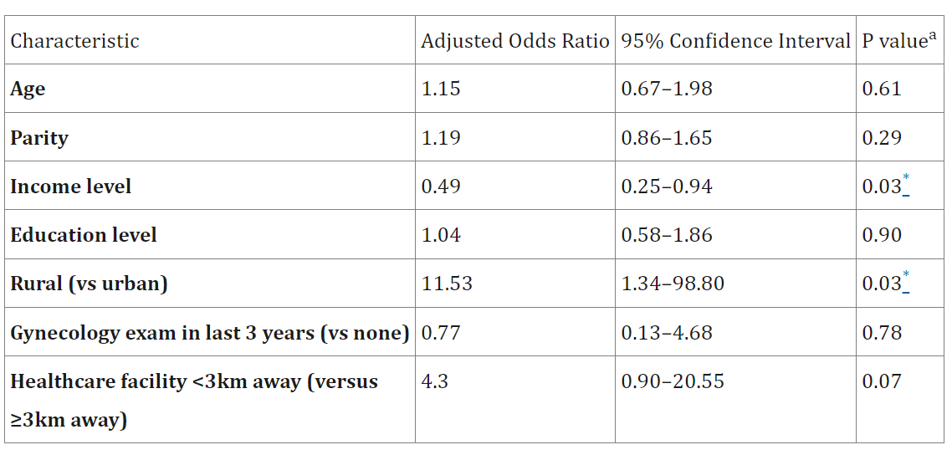
Predictors of presentation at a late stage of cervical cancer: final regression model
(Appiah-Kubi A, et al. 2022. doi: 10.4314/gmj.v56i2.5.)
✔
✔

Slide 35
African Framework Objectives
Introduce and scale up HPV vaccine in routine national immunization programmes
Increase coverage of, and access to screening and appropriate management of precancerous lesions
Increase coverage of, and access to diagnosis and management of cervical cancer and palliative care as needed
Strengthen capacity for monitoring and evaluation of cervical cancer prevention and control for performance tracking

Slide 36
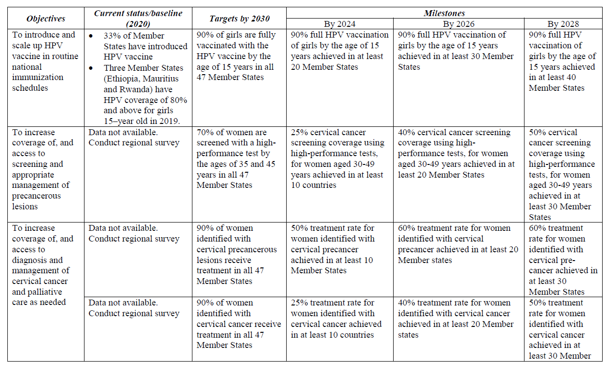
Summary Objectives, milestones, etc

Slide 37
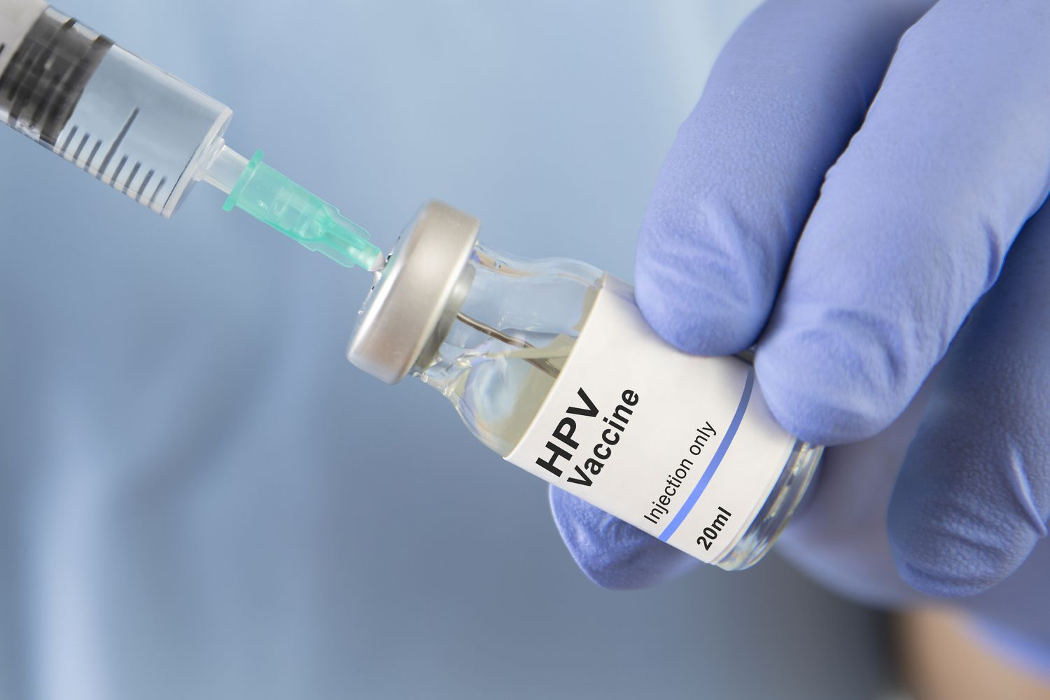
Initiation of Routine HPV Immunization in Nigeria – a good first step

Slide 38
Why HPV vaccination first?
Most effective of the three strategies!
Evidence:
HPV immunisation with Cervarix (bivalent) was introduced in England, UK, in Sept 1, 2008. An audit of national Data in January 2021 showed:
“substantial reduction in cervical cancer & incidence of CIN3 in young women after the introduction of the HPV immunisation…
HPV immunisation programme has successfully almost eliminated cervical cancer in women born since Sept 1, 1995” (Falcaro et al. 2021 DOI: 10.1016/S0140-6736(21)02178-4)

Slide 39
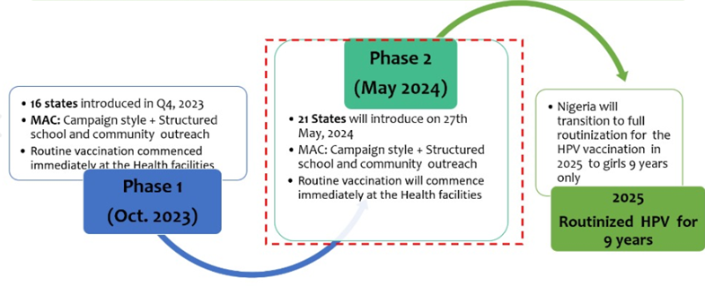
Nigeria HPV Vaccine Rollout Plan
(https://nphcda.gov.ng)

Slide 40
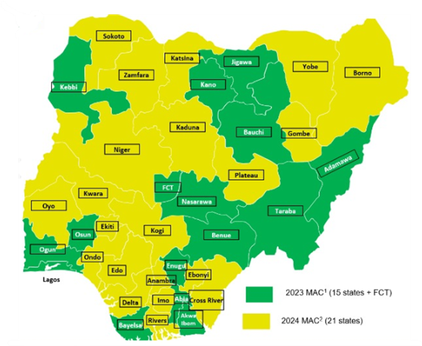
Nigeria HPV Vaccine Rollout Plan by States
(https://nphcda.gov.ng)
Aim = vaccinate 17 million girls by 2025
Nigeria has done well
By September 2024, > 12 million girls → vaccinated
SOGON can help validate this claim through survey of secondary school girls in Nigeria

Slide 41

Defining the Next Steps

Slide 42
A) Enhancing Routine HPV Immunization
Build trust regarding the safety & effectiveness of HPV vaccine
  Continued education of parents & child girl
    Channels – Women groups (religious, community), school clubs/societies, etc
HPV vaccine education in the long-term
  Secondary school curriculum & universities GS curriculum adjustment
    Incorporate reproductive cancer education - SOGON can champion this
Ensure the quality of the vaccine coverage data published by Nigerian agencies & partners,
  Enhanced M & E of routine HPV immunisation in Nigeria

Slide 43
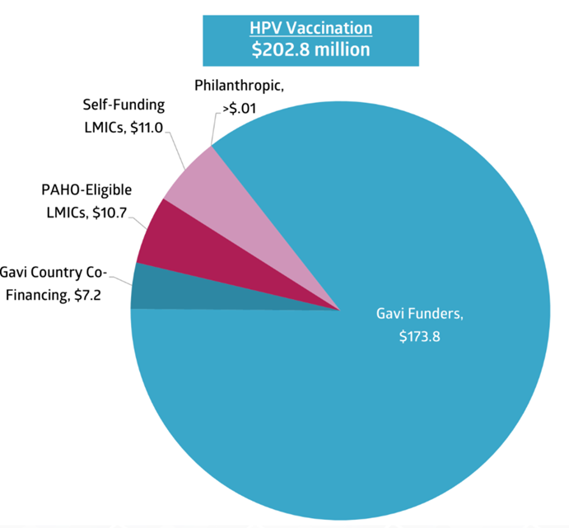
B) Self-Reliance in Vaccine Procurement & Production
LMICs HPV vaccination Investment - 2023
Substantial increase
Only 5% → self-funded
Implication:
  No routine HPV immunization without donor support
CC Prevention Funding in LMICs in 2023
(https://togetherforhealth.org)

Slide 44
C) Develop Routine Cervical Cancer screening
Vaccination → save future generations of girls
CC screening & early treatment → save lives today
Recommended CC screening → high-performance methods
  HPV nucleic acid tests → HPV DNA (WHO, 2021) or HPV mRNA test (WHO, 2024)
Nigerian situation
  No organized national CC screening programme
  VIA or Pap test → predominant but, coverage → low
  Improvement strategies in Nigeria → Multi-faceted approaches

Slide 45
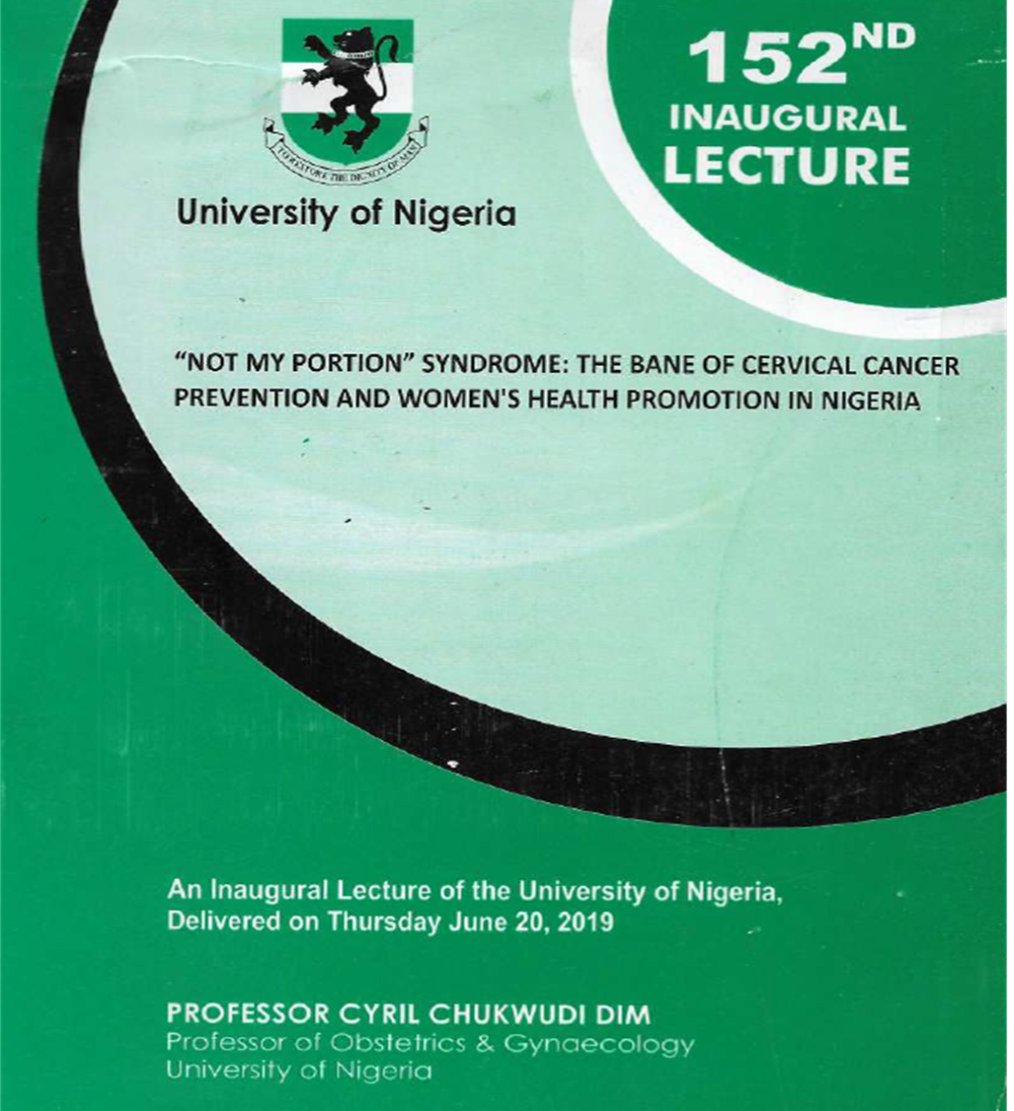
Strategies to improve CC screening in Nigeria-1
CC screening → should be routine
  Like HPV immunization
Financing should be:
  Health insurance or
  Direct government payment
Out-of-pocket payment for dx screening by healthy persons
  ↑“Not-My-Potion syndrome”(Dim, 2019)
(https://drive.google.com/file/d/16x6gpaxPNEm7_2b57m_FWZJ_4z-MtMah/view?usp=sharing)

Slide 46
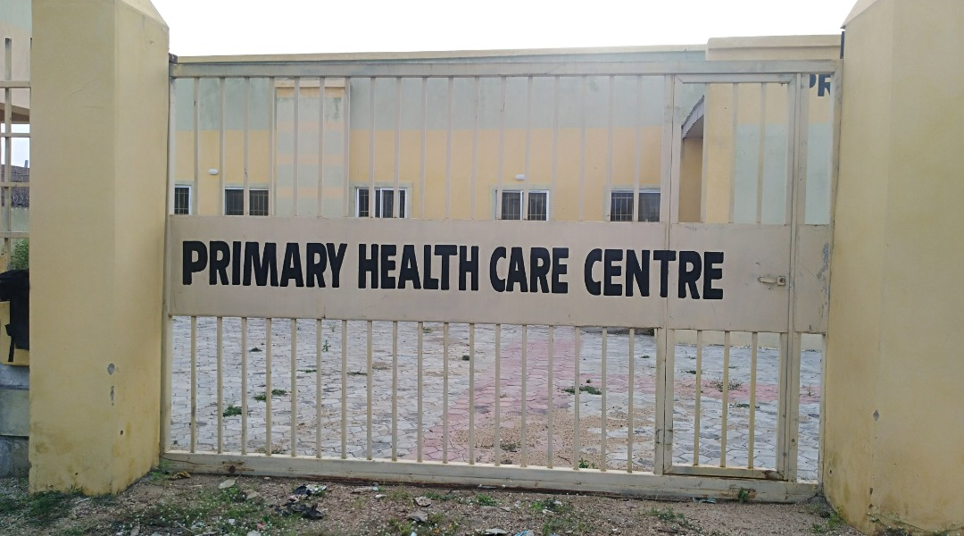
Strategies to improve CC screening in Nigeria-2
Strengthening the Primary health care system to offer CC screening
  Only way CC screening can reach the communities effectively!
Requires unity of purpose b/w LGAs & State government agencies
  Improved salary of staff
  Large-scale training of medical doctors & nurses
  Medical school curriculum: CC & breast cancer screening → MUST know skills

Slide 47

Strategies to improve CC screening in Nigeria-3
Develop a registry
  Invite women for CC screening
The telcos can assist

Slide 48
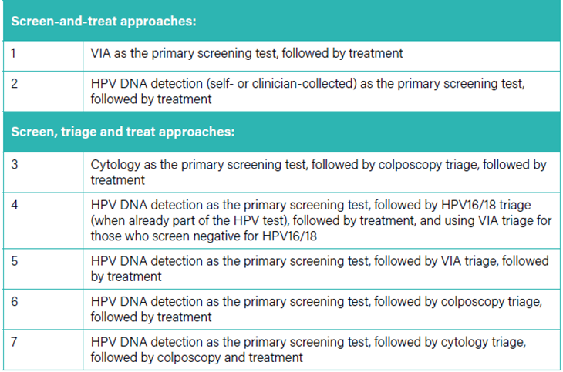

D) Scaling up Cervical Pre-cancer treatment
Recommended CC Screening & Treatment Algorithm
(WHO Guidelines, 2021)
Cervical pre-cancer treatment → component of CC screening
Recommendation for general pop.
  See-and-treat & See-triage-treat approaches
  Followed by ablative treatment in a single-visit approach
  Plus, functional referral & linkage system
    for evaluation of women ineligible for ablative treatment
Nigeria should adopt algorithms 2 & 4

Slide 49
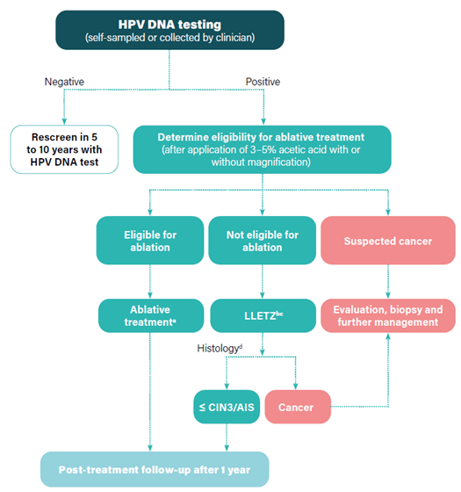
Algorithm 2: Primary HPV DNA Test Screening
(See & Treat Approach)

Slide 50
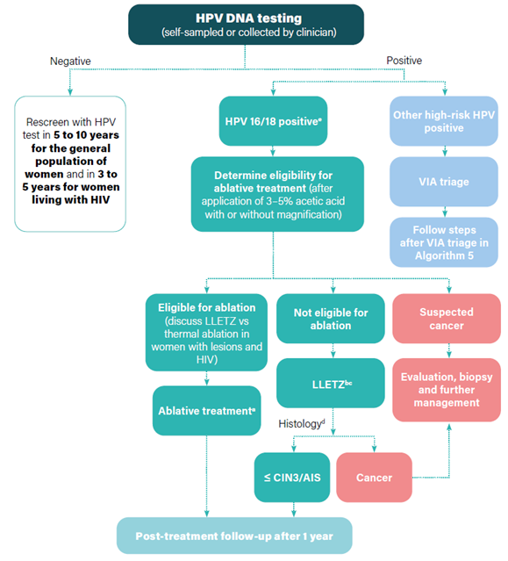
Algorithm 4: HPV DNA Screening & HPV 16/18 Triage
(Screen, Triage & Treat Approach)

Slide 51
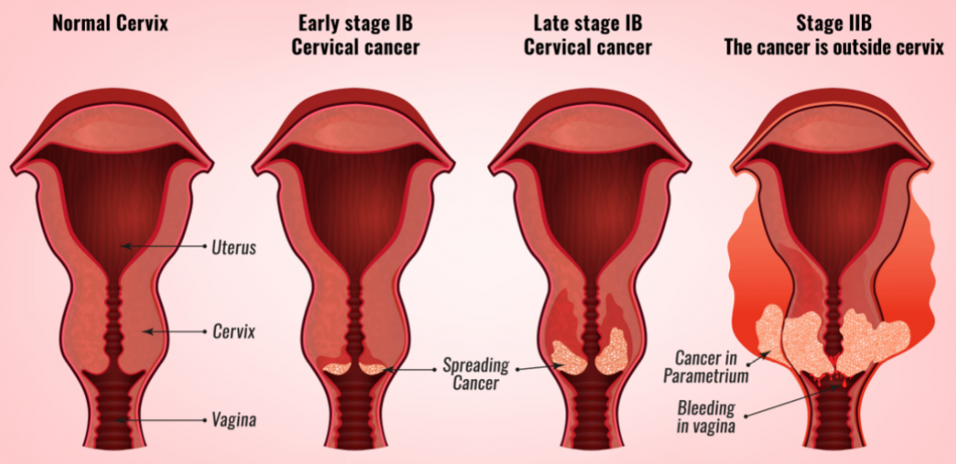
E) Scaling up of cervical cancer treatment
Early-stage CC (≤ 2a) → curable by radical surgery or radiotherapy
Most pt present with advanced CC → Palliative treatment
https://www.obermair.info/latest-news/blog/stages-of-cervical-cancer/

Slide 52

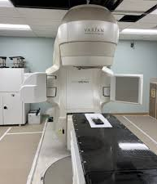
Impediment to scaling up CC treatment
1) Sub-optimal surgical capacity
2) Sub-optimal radio-oncology services
So, what do we do?

Slide 53
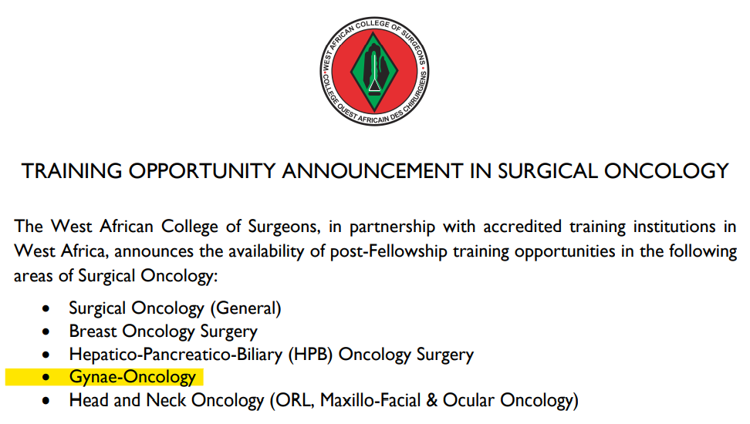

Efforts at Narrowing Surgical Capacity Gaps-1
Subspecialty training in Gynae-oncology by NPMCN & WACS
  Status: infantile → medium to long-term intervention

Slide 54
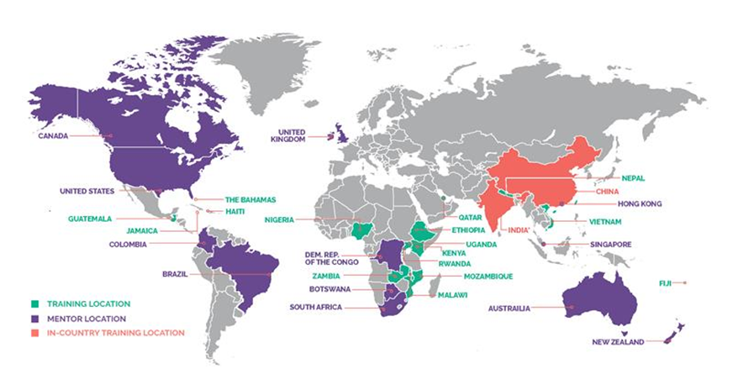
Efforts at Narrowing Surgical Capacity Gaps-2
International Gynecologic Cancer Society (IGCS) Global Gynecologic Oncology Fellowship Program
  Status: Growing → Medium to long-term intervention
Centers in Nigeria
Enugu
Lagos
Ibadan
Kaduna

Slide 55
Efforts at Narrowing Surgical Capacity Gaps-3
Gynae-oncology observership in high-income countries
Distance training - online lectures & video demonstrations:
  E.g., Memorial Sloan Kettering Cancer Center (MSKCC) & African Research Group on Oncology (ARGO) collaboration – OAU Ife
All ongoing efforts → further developed and expanded. But,
We need an urgent stop-gap!

Slide 56
Stop-gap for Improving Surgical Capacity for CC Treatment
(Doi: 10.3332/ecancer.2022.1469)
Focused surgical intensification program
Country | Type of physician | Specific objective of training | Adjunct surgery | Outcome of the programme
Malawi | General gynaecologist | Rapidly teach Radical hysterectomy, Pelvic lymphadenectomy for early-stage CC | None. Programme was Specific. | a) Rapid transfer of surgical skills for radical hysterectomy, pelvic lymphadenectomy b) The ability to train other general gynaecologists to perform this specific operation 3. Etc

Slide 57
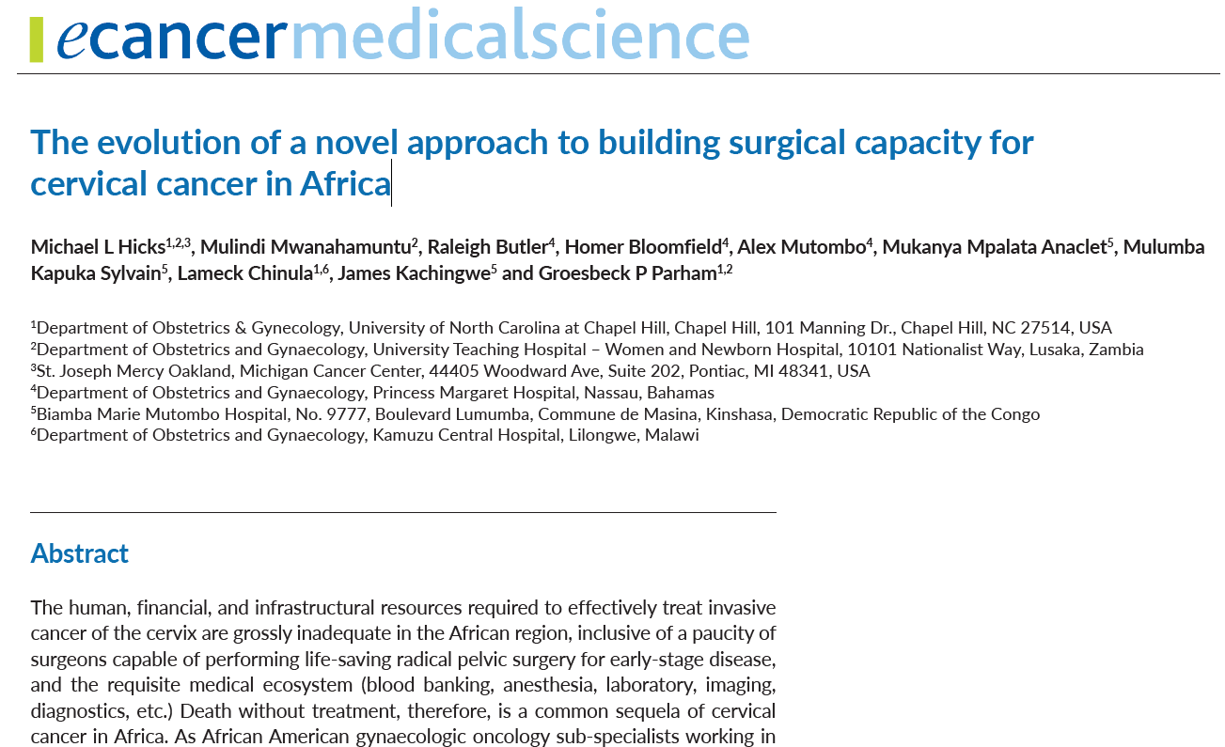
Hicks ML, et al. 2022. Doi: 10.3332/ecancer.2022.1469
The major constraint in their mission in South Africa was:
“some of the general gynaecologists were consumed with demands of private practice, & thus were unable to bring the degree of focus to the training seminars that were required for effective skills transfer...”

Slide 58
Further interventions to improve advanced CC treatment
More functional radio-oncology centers
Expand existing cancer fund & improve ease of access
Strengthen histopathology services of secondary & tertiary health facilities
Manage CC elimination strategy at all tiers of government → as a project
  Develop a dedicated Action committee coordinated by medical experts in CC prevention
    Report directly to the Chief executive

Slide 59
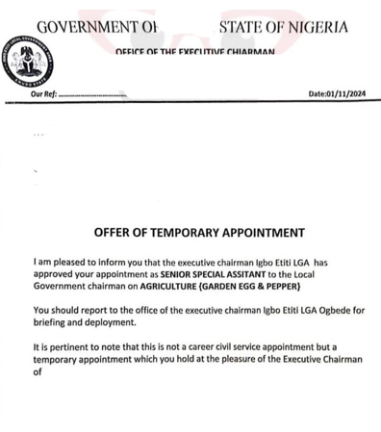
Cervical Cancer Elimination

Slide 60
Conclusion
CC burden in Nigeria → Enormous
CC elimination → Achievable
Routine nationwide HPV immunization → Established & expanding
Next steps to achieve the African Regional Framework milestones:
  Enhancing routine HPV immunization
  Achieving self-reliance in vaccine procurement & production
  Develop routine CC screening and pre-cancer treatment
  Scale up cancer management

Slide 61

Finally,
Spirit of Prof K.O Ogan encourages the SOGON President, Council & members to:
Collaborate with the govt. & other relevant stakeholders &
Implement these well-thought-out steps to accelerate CC elimination in Nigeria

Slide 62
Thank you

Slide 63
References
Appiah-Kubi A, Konney TO, Amo-Antwi K, et al. Factors associated with late-stage presentation of cervical cancer in Ghana. Ghana Med J. 2022;56(2):86-94
Dim CC. “Not My Portion” Syndrome: The Bane of Cervical Cancer Prevention and Women’s Health Promotion in Nigeria. 152nd Inaugural Lecture: University of Nigeria; 2019 June 20. Nsukka, Nigeria: University of Nigeria Press Ltd; 2019. ISBN:978-978-49804-8-7.
Falcaro M, Castañon A, Ndlela B, et al. The effects of the national HPV vaccination programme in England, UK, on cervical cancer and grade 3 cervical intraepithelial neoplasia incidence: a register-based observational study. Lancet. 2021 Dec 4;398(10316):2084-2092.
Ferlay J, Ervik M, Lam F, et al. Global Cancer Observatory: Cancer Today. Lyon, France: International Agency for Research on Cancer. 2024. Available from: https://gco.iarc.who.int/today
Hicks ML, Mwanahamuntu M, Butler R, et al. The evolution of a novel approach to building surgical capacity for cervical cancer in Africa. Ecancermedicalscience. 2022;16:1469
John Hopkins Bloomberg School of Public Health: International Vaccine Access Canter. One Dose at a Time: Mobilizing to Eliminate Cervical Cancer in Nigeria. Published January 30, 2024. Available at: https://publichealth.jhu.edu/ivac/2024/one-dose-at-a-time-mobilizing-to-eliminate-cervical-cancer-in-nigeria
TogetHER for Health. Investing in Global Cervical Cancer Prevention: Resources for Low-Income and Lower Middle-Income Countries in 2023. November 2024. Available at : https://togetherforhealth.org/wp-content/uploads/funding_report_2023_Nov_17_web.pdf
UNICEF. Generations unite in Nigeria’s HPV vaccine campaign. Available at: https://www.unicef.org/stories/generations-unite-nigerias-hpv-vaccine-campaign
WHO guideline for screening and treatment of cervical pre-cancer lesions for cervical cancer prevention: use of dual-stain cytology to triage women after a positive test for HPV. Geneva: WHO; 2024

