Slide 1

Sustaining Quality Maternal and Child Health in a Challenging Economy
Professor Innocent A.O. Ujah
FMCOG, FNAMed, FNMA, mni, OON, NPOM
Pioneer Vice-Chancellor
Federal University of Health Sciences, Otukpo, Nigeria

Slide 2

Outline of Presentation
Introduction
Current State of Nigeria’s Economy
Current State of MCH in Nigeria
Impact of Economic Crises on MCH
What are the drivers of the Current Economic Crisis?
Strategies for Sustaining MCH During Economic Crises
Recommendations
Conclusion

Slide 3
Background
Evidence suggests higher incomes and wealth are strongly associated with better health
Conventional thinking is economy impacts health, however, a bidirectional relationship exists
As economy of a country improves, health of its citizens improves
Improving the health of a nation’s citizens can directly result in economic growth (though less obvious)
Therefore, economic instability is likely to impact on the health of the population and health systems
Notes:
Income/wealth, is one of the critical social determinants of health
As the economy of a country improves, so the health of its citizens improves
The relationship between economic crises and health is fundamentally counter-cyclical

Slide 4
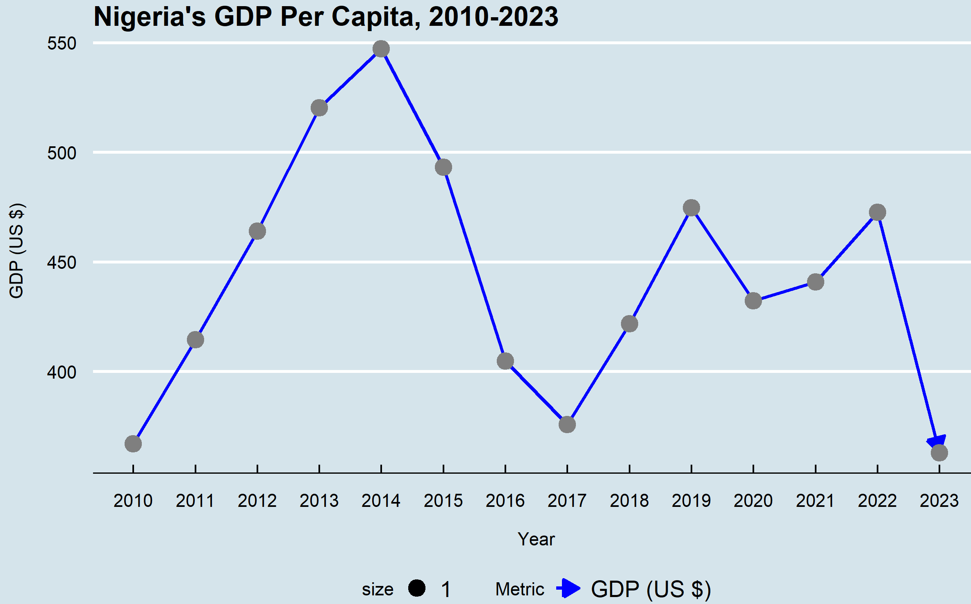

Current State of Nigeria’s Economy
MDG era
SDG era
GDP 2023: $362,814,951.70
Source: World Bank
Notes:
These trends suggest an initially robust economic expansion that encountered significant setbacks due to likely economic or external shocks around 2015-2016 and again in 2020.
The declines in GDP and growth rates during these periods may indicate vulnerability to internal challenges or global events, such as commodity price drops or the COVID-19 pandemic.
The recovery post-2020 appears slow and fragile, with limited growth stabilization but no substantial GDP rebound, indicating persistent underlying economic challenges or slow structural adaptation.
This pattern may highlight the need for strengthened resilience and diversified economic strategies to support more sustainable growth.

Slide 5
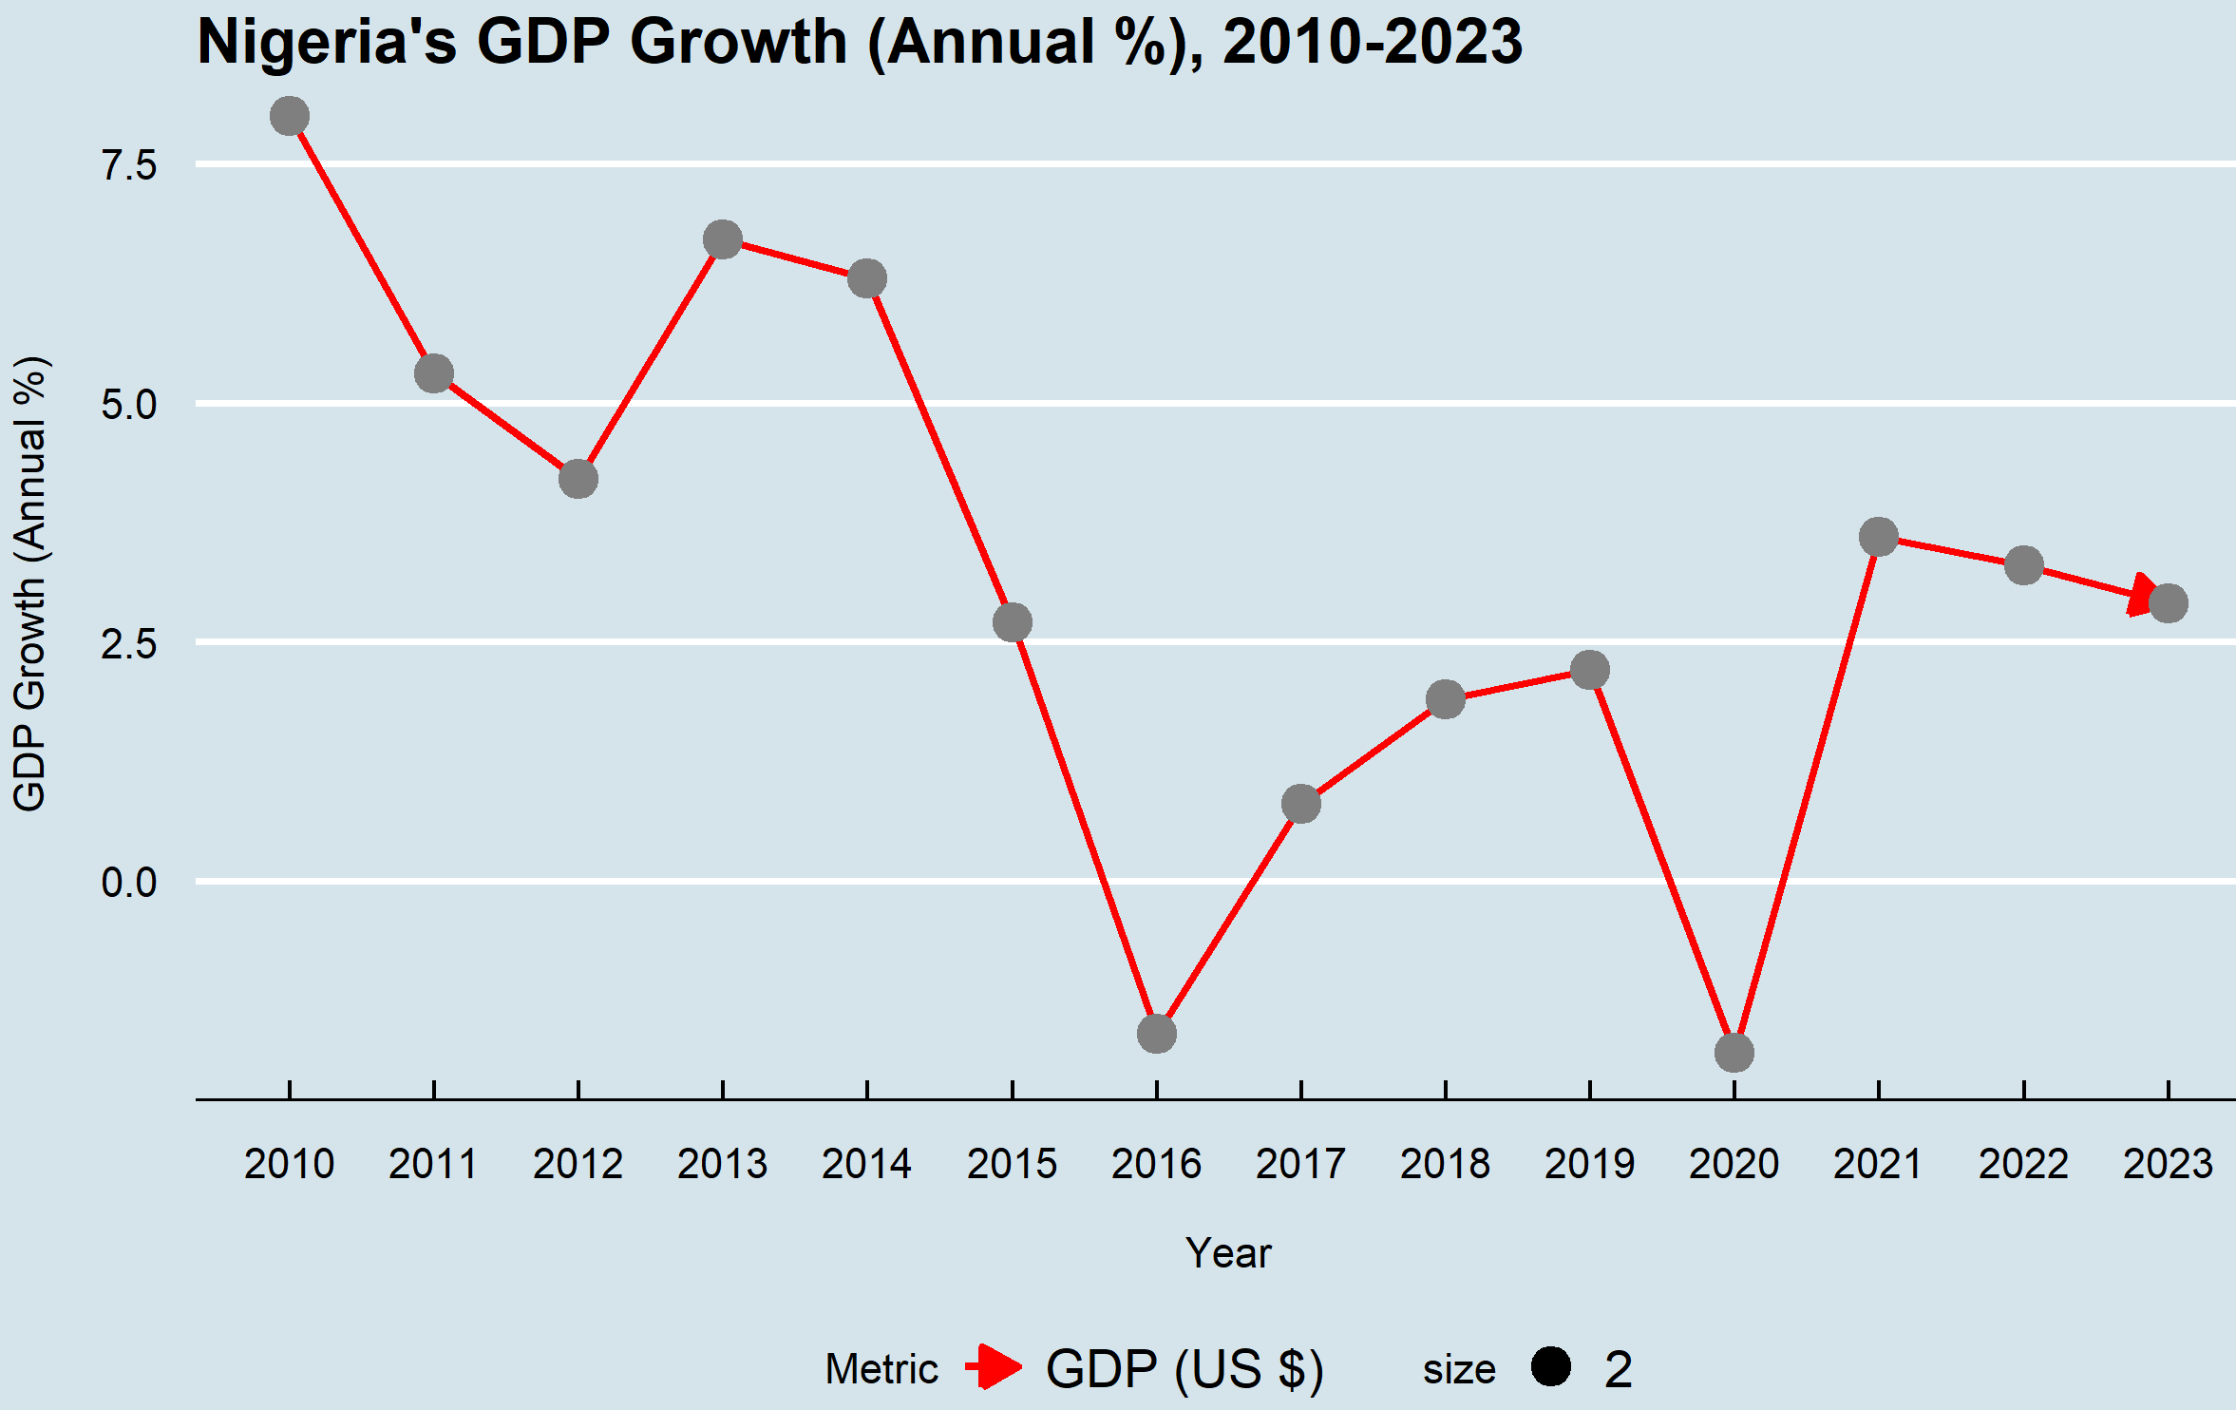

MDG era
SDG era
GDP Growth 2023: 2.9%
Source: World Bank
Notes:
These trends suggest an initially robust economic expansion that encountered significant setbacks due to likely economic or external shocks around 2015-2016 and again in 2020.
The declines in GDP and growth rates during these periods may indicate vulnerability to internal challenges or global events, such as commodity price drops or the COVID-19 pandemic.
The recovery post-2020 appears slow and fragile, with limited growth stabilization but no substantial GDP rebound, indicating persistent underlying economic challenges or slow structural adaptation.
This pattern may highlight the need for strengthened resilience and diversified economic strategies to support more sustainable growth.

Slide 6
Pathways linking economy and health
Effect of economic shocks act through multiple inter-related pathways to influence health outcomes
    Stress mechanism: increased stress may induce depression or anxiety
    Effect of budgeting mechanism: fewer financial resources will reduce their health investment activities – delay or forgo preventative or curative care
    Frustration-aggression mechanism: individuals who are denied an expected reward may experience psychosomatic antecedents of aggression
Notes:
Income/wealth, is one of the critical social determinants of health
As the economy of a country improves, so the health of its citizens improves

Slide 7
Economy and Heath
Economic downturns are a recurrent phenomenon
Negative health implications of economic crises are manifold and a major concern globally
Declining GDP adversely affects the population’s health (Prędkiewicz et al, 2022)
Women, infants and children are disproportionately affected
Growing concern is that with economic declines, achievement of SDGs would slow or even stall
Maternal and child health is of particular concern, many countries, including Nigeria, already falling short of the SDG benchmarks for 2030

Slide 8
Maternal and Child Health
Maternal and child health (MCH) remains a global public health priority
MCH is measured by maternal and neonatal mortality and other routinely collected outcomes
Historically, the global financial crisis of 2008 provided recent lessons about the effects of socioeconomic shocks on MCH
Notes:
Income/wealth, is one of the critical social determinants of healthGrowing concern that achievement of SDGs would slow or even stall
COVID pandemic and associated economic and social implications similar to the Great Recession

Slide 9
Current state of MCH in Nigeria
Nigeria accounts for nearly one-third (28.5%) of global maternal deaths
In 2020, Nigeria’s MMR = 1,047 deaths/100,000 live births (very high)
Under-5 Mortality Rate: 117 per 1,000 live births
Limited access to quality antenatal, postnatal, and child healthcare, especially in rural areas
Shortage of well-trained and adequately compensated healthcare providers (“Japa” syndrome)
Unaffordable out-of-pocket expenses for healthcare services
Limited health insurance coverage for women and children
Notes:
Income/wealth, is one of the critical social determinants of health
Growing concern that achievement of SDGs would slow or even stall
COVID pandemic and associated economic and social implications similar to the Great Recession

Slide 10
Impact of MCH on economy
Enhanced economic opportunities and empowerment
a. Improved long term workforce productivity
b. Pursue education and drive growth in their
communities
c. Improvement in livelihoods
d. Contribute to increased national wealth

Slide 11
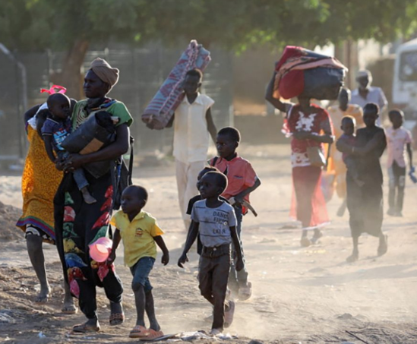




Worsening economic crises due to COVID-19, conflict and climate change (3C’s)
Notes:
Measures taken to limit spread of COVID-19 triggered slower pace of economic growth

Slide 12
Impact of economic decline on MCH
Delayed Access to Care
    Late/no antenatal care (ANC) initiation
    Reduced postnatal care (PNC) coverage
Negative Health Outcomes
    Maternal, perinatal, and child malnutrition
    Pregnancy-related anemia
    Increased risk of low birth weight
    Higher infant mortality (girls > boys)
Restricted Healthcare Access
    Limited immunization coverage
    Ministry budget cuts → shortage of supplies, especially in primary care
Notes:
Early (within the first trimester) and regular PNC is known to be an important strategy for improving health outcomes for mothers and infants
The infant mortality rate (IMR) correlates closely to the level of GDP per capita over time.
As economic growth and GDP per capita declines, there will be an increase in infant mortality.
The World Bank estimates that a decline in GDP per capita of one or more points increases average infant mortality by 7.4 deaths per 1,000 births for girls and to 1.5 deaths for 1,000 births for boys.
In a 2008 World Bank paper, infant deaths are correlated to the “macroeconomic conditions around birth, rather than in the early in-utero period or in the latter half of a child’s first year of life, which matter most for a child’s survival in her first year”
Potential to cripple health systems

Slide 13
Effects of economic shocks on MCH: Lessons from 2008 global financial crisis
In some LMICs, a 10% decrease in GDP linked to an 8.5% increase in maternal mortality, with adolescent mothers particularly affected
A 5% reduction in GDP per capita in 2020 was estimated to result in an additional 282,996 deaths in children under 5 in 2020 in 129 LMICs (Cardona et al, 2022)
In Portugal (2007–2014), a 25% rise in low birth weight occurred alongside reductions in GDP, health spending, and social support, impacting especially children of migrant mothers
Notes:
Jacob CM, Briana DD, Di Renzo GC, Modi N, Bustreo F, Conti G, Malamitsi-Puchner A, Hanson M. Building resilient societies after COVID-19: the case for investing in maternal, neonatal, and child health. Lancet Public Health. 2020 Nov;5(11):e624-e627. doi: 10.1016/S2468-2667(20)30200-0. Epub 2020 Sep 21. PMID: 32971008; PMCID: PMC7505549.

Slide 14
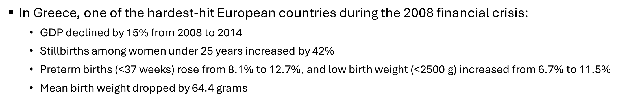
Effects of economic shocks on MCH: Lessons from
2008 global financial crisis

Slide 15
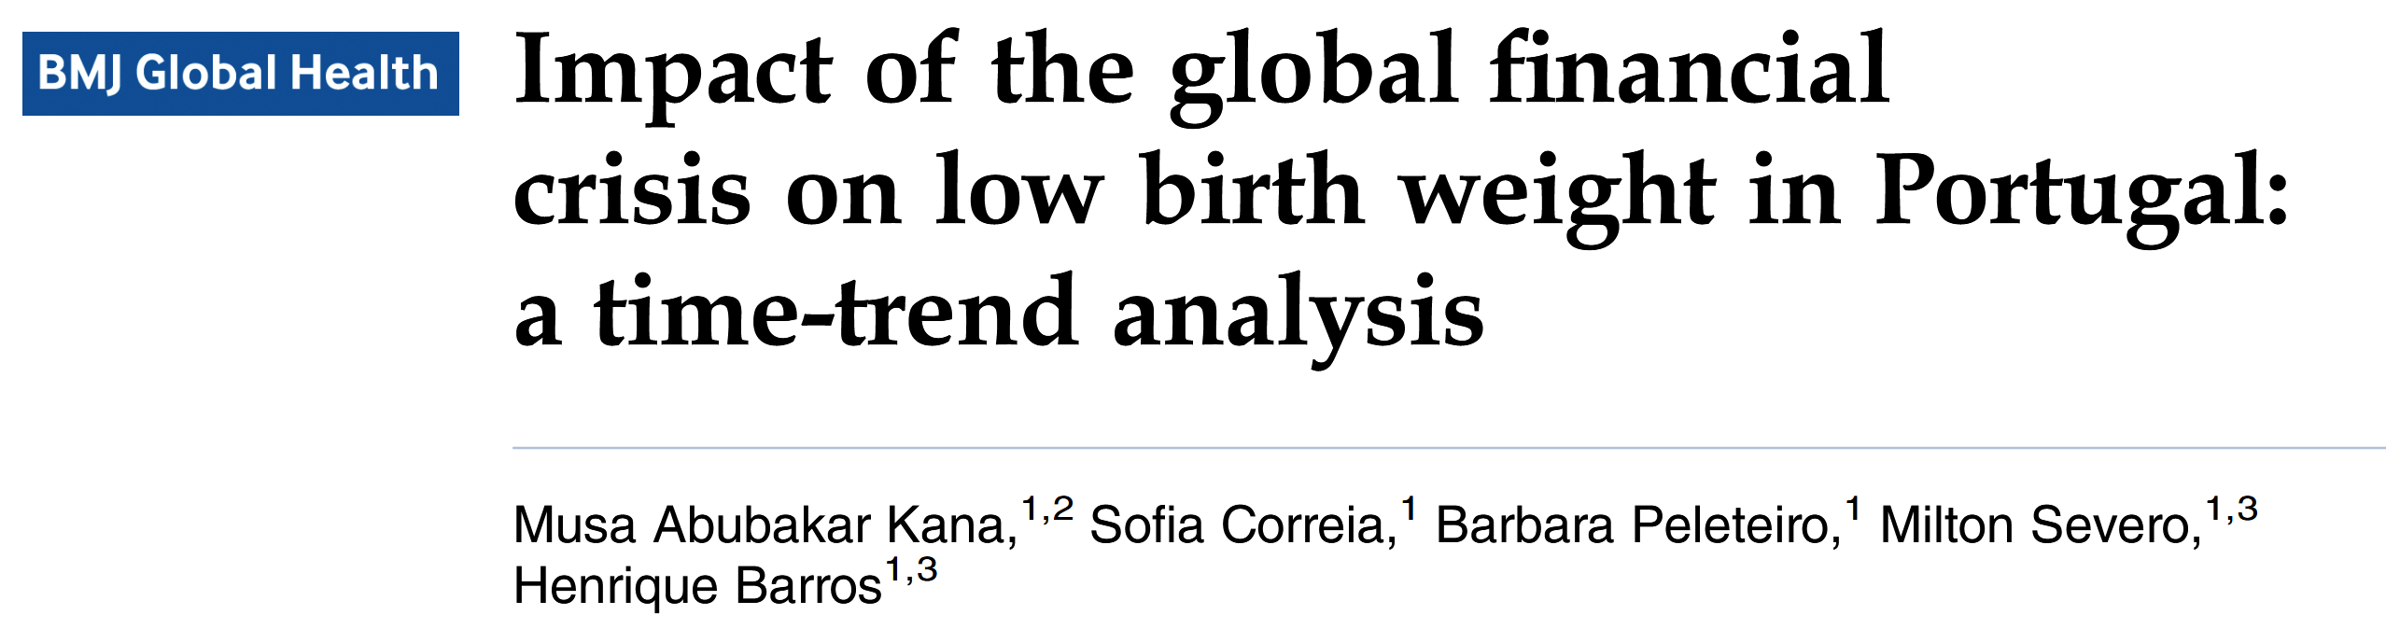
“… global financial crisis was associated with a significant increase in low birth weight, particularly among infants of non-Portuguese mothers”
Kana MA, Correia S, Peleteiro B, et al. Impact of the global financial crisis on low birth weight in Portugal: a time-trend analysis. BMJ Global Health 2017;2:e000147.doi:10.1136/bmjgh-2016-000147

Slide 16
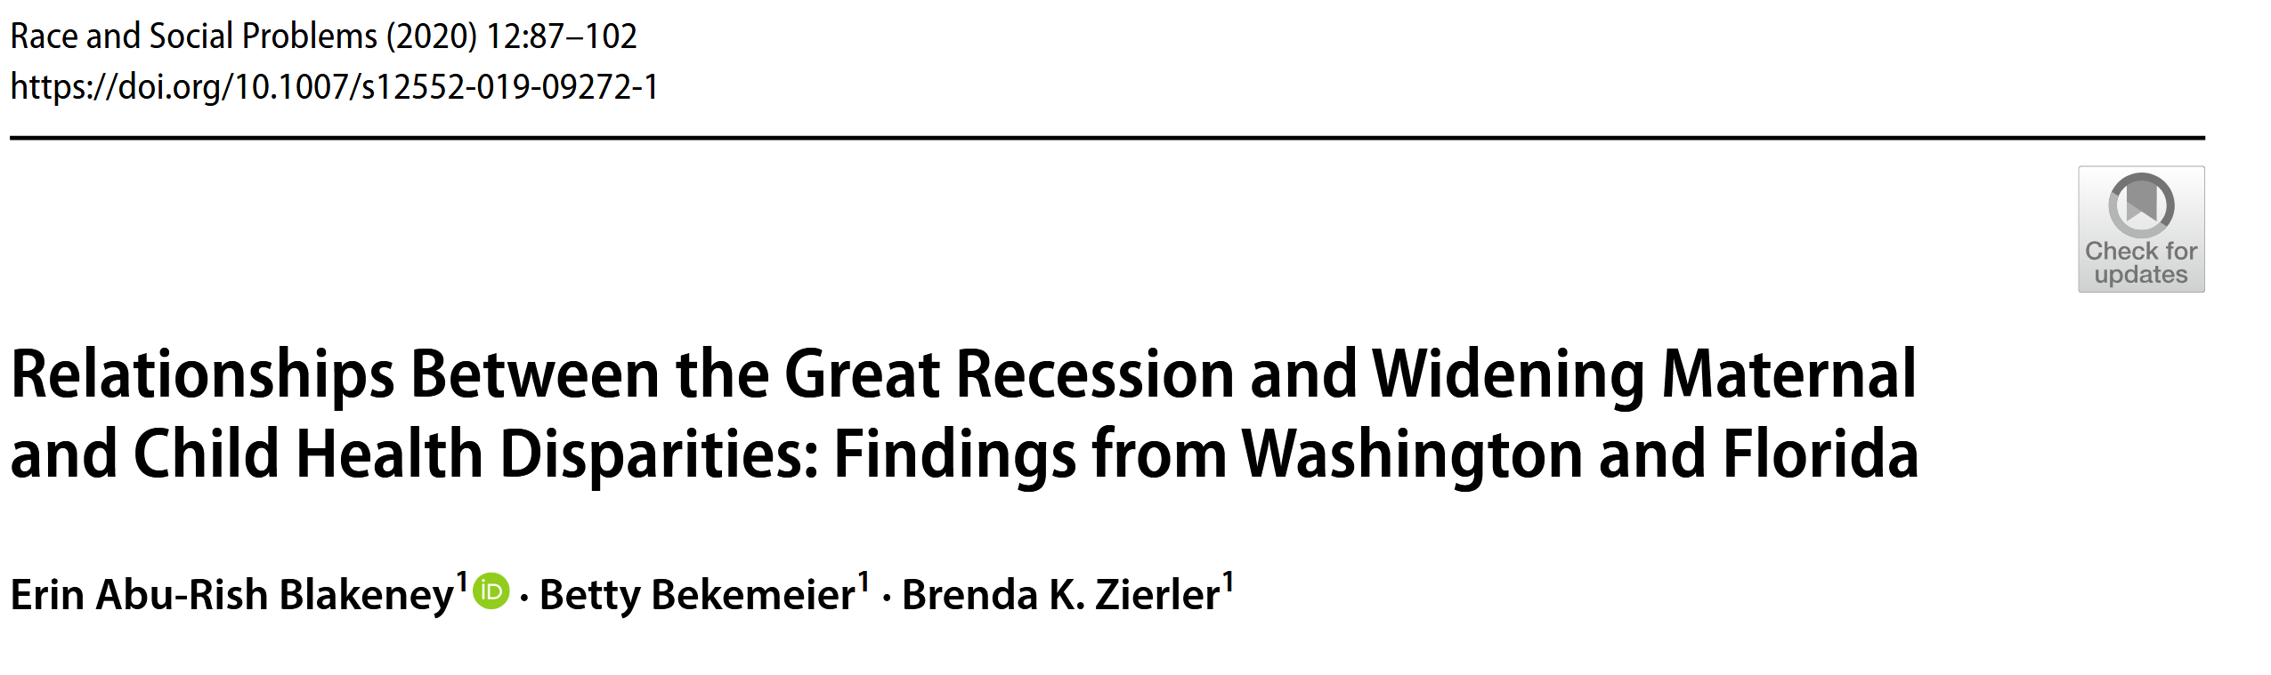
“… expected increases in need during the Great Recession, and worsening MCH outcomes and disparities”
Kana MA, Blakeney EA, Bekemeier B, Zierler BK. Relationships Between the Great Recession and Widening Maternal and Child Health Disparities: Findings From Washington and Florida. Race Soc Probl. 2020 Jun;12(2):87-102. doi: 10.1007/s12552-019-09272-1.

Slide 17
Food for Thought
What impact is the current economic crisis in Nigeria likely to have on maternal and child health (MCH), especially for the poorest and most vulnerable groups?
How well are current health financing systems in Nigeria well placed to respond to the needs of women and their children with the current economic decline?
Notes:
Innovative, solutions-driven science is essential to rigorously test and advance actionable and effective solutions that can protect and ensure the sustainability of MCH in these challenging times

Slide 18
What can be done to mitigate the impact of economy on MCH?
Global problem requiring local solutions
Enhanced Surveillance
Efficient monitoring and surveillance systems for MNCH are needed to help governments to monitor and report on the after-effects of the pandemic efficiently, including behavioural factors and socioeconomic markers, using qualitative and participatory approaches
Track indicators: facility-based deliveries, low birth weight, weight-for-height
Better collection and analysis of data, disaggregated by age,
Sustained access to sexual and reproductive health services
Effective responses to violence against women

Slide 19
What can be done to mitigate the impact of economy on MCH?
2. Increased MCH Investment
Performance-based contracts
Public-private partnerships
Resource Efficiency
Optimize volume and costs of MCH resources used

Slide 20
What can be done to mitigate the impact of economy on MCH?
Investing in MNCH offers high rates of return in the medium to longer term, and reduces the burden of short-term adverse outcomes such as maternal mortality, child deaths, and stillbirths
Interventions to promote early-childhood health and development, including the training and provision of community health worker

Slide 21
What can be done to mitigate the impact on MCH?
Social Protection Initiatives systems
Conditional cash transfers, social health insurance, subsidies, voucher systems stronger to help cope with escalating out-of-pocket expenses of households, impacts on productivity, and reduced earning capacity
Community-Based Interventions
Promote prevention, ownership, and sustainability
Donor Coordination
Map assistance networks to improve efficiency
Social networks and professional organizations overseas to obtain financial donations and drugs, consumables, and equipment

Slide 22
What can be done to mitigate the impact of economy on MCH?
Greater reliance on clinical judgment during clinical practice rather than laboratory investigations,
Development of appropriate cost-effective protocols for management, and prescribing of generic medicines that are cheaper
Improve efficiency by reorganizing service delivery (eg, strengthening primary health care services and an appropriate referral system

Slide 23
  Recommendations on how to sustain quality maternal and child healthcare (MCH) in a challenging economy like Nigeria

Slide 24
HOW TO SUSTAIN QUAILTY MATERNAL AND CHILD CARE IN A CHALLENGING ECONOMY LIKE NIGERIA
INTEGRATE SERVICES Combine MCH services with other primary healthcare services to reduce costs and improve efficiency.
TASK SHIFTING/SHARING Train lower-level health workers to also perform tasks normally done by higher-level professionals, like midwives performing routine antenatal care.
COMMUNITY ENGAGEMENT Involve communities in MCH care through volunteer programs, peer support groups, and health education.

Slide 25
HOW TO SUSTAIN QUAILTY MATERNAL AND CHILD CARE IN A CHALLENGING ECONOMY LIKE NIGERIA-1
PUBLIC-PRIVATE PARTNERSHIPS Collaborate with private sector organizations to leverage resources, expertise, and funding.
TECHNOLOGY UTILIZATION Use of mobile health technologies, telemedicine, and electronic health records to improve access and efficiency.
PRIORITIZATION OF PREVENTIVE CARE Focus on preventive services like immunization, family planning, and antenatal care to reduce costly complications.

Slide 26
HOW TO SUSTAIN QUAILTY MATERNAL AND CHILD CARE IN A CHALLENGING ECONOMY LIKE NIGERIA-2
CAPACITY BUILDING Invest in training and capacity building for healthcare workers to improve quality of care.
Efficient use of resources Optimize use of available resources, like leveraging existing infrastructure and supplies (equipment maintenance and timely replacement).
Advocate for policy support Push for policies that support MCH care, like increased funding, Family planning subsidies, or tax exemptions.

Slide 27
HOW TO SUSTAIN QUAILTY MATERNAL AND CHILD CARE IN A CHALLENGING ECONOMY LIKE NIGERIA-3
MONITOR AND EVALUATE*: Regularly monitor and evaluate MCH services to identify areas for improvement and optimize resource allocation.
COMMUNITY-BASED INITIATIVES*: Support community-based initiatives and grassroots organizations focused on MCH care.
LEVERAGE GLOBAL PARTNERSHIPS*: Collaborate with international organizations and global health initiatives to access funding, expertise, and resources.

Slide 28
Conclusion
Economic crises heighten risks for adverse MNCH outcomes
Urgent need for mechanisms to shield vulnerable groups – especially women, children, and infants, from economic fluctuations to ensure continuity in care and support.
Previous crises provide insights for policy
Investing in MNCH is essential for economic stability and growth
COVID-19, conflict, and climate change compound existing issues

Slide 29

Thank You!

